Slide 1
T Levels @ HSDC
Ashley Grute- Director of Curriculum

Slide 2
DfE new promotional video
https://youtu.be/XYQw5rQrwwA

Slide 3
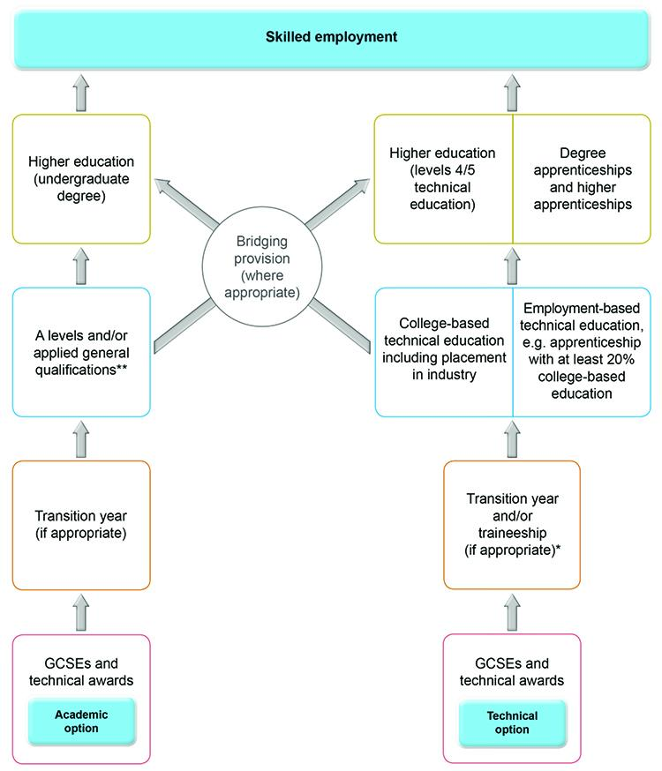

Slide 4
What are T Levels?
Level 3 2-year technical qualifications
15 different routes with different pathways
Equivalent to 3 A Levels
Combination of classroom theory, practical learning and a minimum of 315 hrs Industrial Placement
Focus on development of skills for employment
Enables progression into employment, higher apprenticeships or HE

Slide 6
When are T Levels coming?
Pathways available from 2020:
Education & Childcare
Construction (Design, Surveying and Planning)
Digital (Production, Design and Development)
Pathways available from 2021:
Health and Science (Health; Healthcare Science; Science)
Construction (Onsite; Building Services)
Digital (Support and Services; Business Services)
Beyond:
2022: Legal, Finance & Accounting; Engineering & Manufacturing; Business & Administration
2023: Animal Care; Creative & Design; Hair & Beauty; Catering & Hospitality

Slide 7
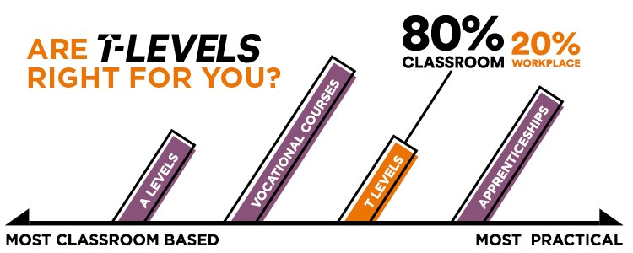
Why should you take a T Level?
New, state-of-the-art qualifications developed with employers
Fantastic new equipment and facilities
Complete focus on development of skills for employment
Recognised by universities
Combines workplace learning and education

Slide 8
Content
-Core Content: Under-pinning knowledge, assessed externally, graded A*-E
-Occupational Specialism: Relevant to specific occupational roles, synoptic assessment, grade Pass/Merit/Distinction
-Industrial Placement: 315 hrs placement, students complete a work project, placement is Pass or Fail
-English, maths and Digital: Students must have completed L2 English and maths to pass the T Level; relevant Digital Skills will be developed depending on T Level route
-Other requirements: Any other qualifications required by T Level panels for employment in that sector (An example would be Food Hygiene Certificate for Catering route)

Slide 9
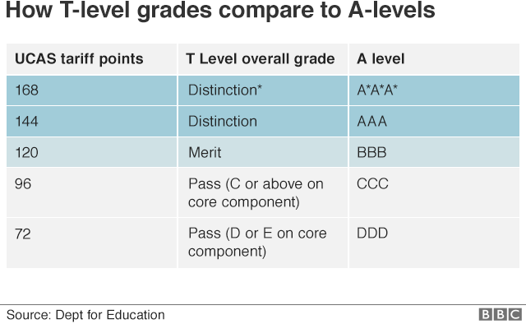
UCAS Tariff

Slide 10
https://www.youtube.com/watch?v=J4hdOsUbYF0

Slide 11
Any questions?
hsdc.ac.uk
@Be_HSDC

