Slide 1
T LEVEL IN DESIGN, SURVEYING AND PLANNING FOR CONSTRUCTION
Supporting holistic delivery of Core Content and
Occupational Specialism content – Measuring the built environment

Slide 2
Lesson 1
Measuring dimensions

Slide 3
Learning aims-lesson 1
Appreciate the effect of measuring equipment on accurate measurement.
Calculate area, perimeter, and volume.

Slide 4
Lesson 1 overview
Measure different 2D and 3D objects using different measurement equipment.
Calculate area, perimeter, and volume.

Slide 5
Measure dimensions - length
Work in pairs.
Measure the length of the given items using the measuring equipment available.
Note your measurements in the Template to record measurement.
Present your data to the rest of the class when asked.

Slide 6
Assess the measuring equipment
Were there any problems measuring with a plastic ruler or a steel rule?

Slide 7
Practical measurement
Work in pairs.
Measure a 3D object in the room (e.g. desk, window).
Note safety considerations when measuring above height.
Record the measurement on the Template to record measurement.
Share your data with the class.

Slide 8
Calculating perimeter
Perimeter is calculated by adding all the sides of a given shape.
Perimeter (P) = a+ b+ a+ b
= 2a+ 2b
b
a
a
b
If side a = 2cm and side b = 4cm
Then P = (2x2) + (2x4)
= 12cm

Slide 9
Calculating area
Area is calculated by multiplying the length by the width of a given shape.
Area (A) = length x width
= a x b
b
If side a = 2cm and side b = 4cm
Then A = 2cm x 4cm
= 8cm²
a

Slide 10
Calculating volume
Volume is calculated by multiplying the length by the width by the thickness of a given shape.
Volume (V) = length x width x thickness
= a x b x c
b
If side a = 2cm, side b = 4cm and
side c = 2cm
Then V = 2cm x 4cm x 2cm
= 16cm³
c
a

Slide 11
Giving measurement instructions
Individually select an item in the learning environment to be measured.
Write instructions for what needs to be measured. The data collected will be used to calculate the volume. Be clear, detailed and precise.

Slide 12
How were the instructions?
Pass your instructions to another learner.
Review the measuring instructions you were given.
Did the instructions include each data point to be measured?
Were there sufficient data points mentioned?
Annotate the instructions with any feedback.

Slide 13
Estimate room dimensions
Work in pairs.
Measure the room dimensions using a piece of string.
Estimate the room dimensions. Use the arm lengths method.
Wrist to elbow (forearm) = 10-11 inches.
Elbow to fingertip = 16-18 inches.
Arm span = your height.

Slide 14
Convert imperial to metric
1 inch = 2.5cm
12 inches = 30cm
Convert your ‘arms lengths’ to a metric measurement.

Slide 15
Measure room dimensions
Work in pairs.
Measure the room dimensions using a tape measure. using a piece of string.
How does your measurement compare to your estimate?
What are the implications of using estimates in construction?

Slide 16
Implications of estimation in construction
Structural failures and safety risks.
Increased costs and waste.
Poor quality and non-compliance.
Reduced durability and performance.
Damage to reputation.

Slide 17
Complete the exam-style questions
Context: A construction company has a plot of land with five sides. They want to develop a rectangular plot for a new housing project.
Question: Explain two implications of failing to obtain accurate measurement data for the plot.

Slide 18
Model answer
The development may extend beyond the boundary. This could lead to a legal case as the development is using land that belongs to someone else.
The development may not be able to achieve the expected footprint of the buildings. This could lead to lower prices and, overall, a financial loss for the project.

Slide 19
Lesson 2
Accuracy and tolerance in measurement

Slide 20
Learning aim-lesson 2
Understand the consequences of inaccurate measurement in construction.

Slide 21
Lesson 2 overview
Carry out construction tolerance calculations.
Learn about types and causes of errors in measurement and carry out calculations to see the impact.
Research different types of measurement tools, produce a presentation and select the most appropriate for different situations.
Consider ‘what if?’ situations.

Slide 22
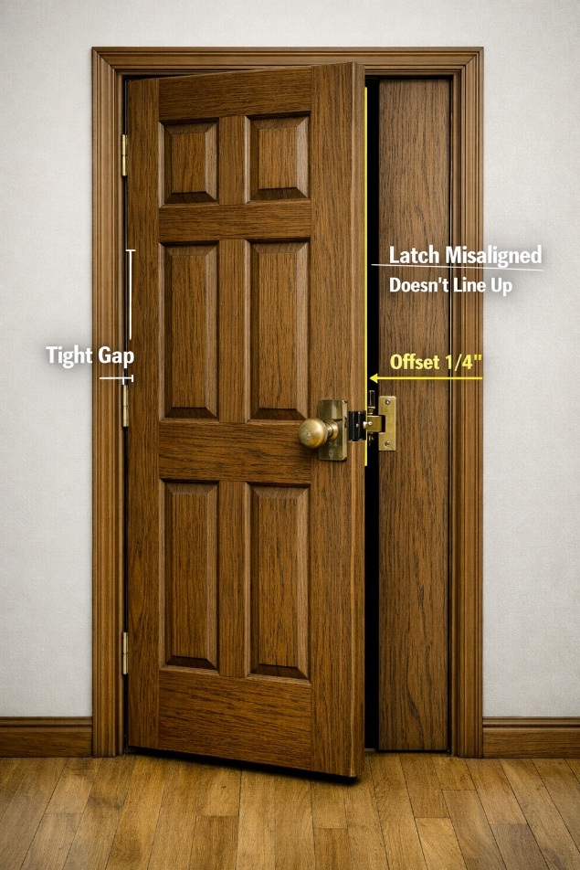
What do you see?
OpenAI (2026) Narrow door frame [Image]. Generated using AI (M365 Copilot).

Slide 23
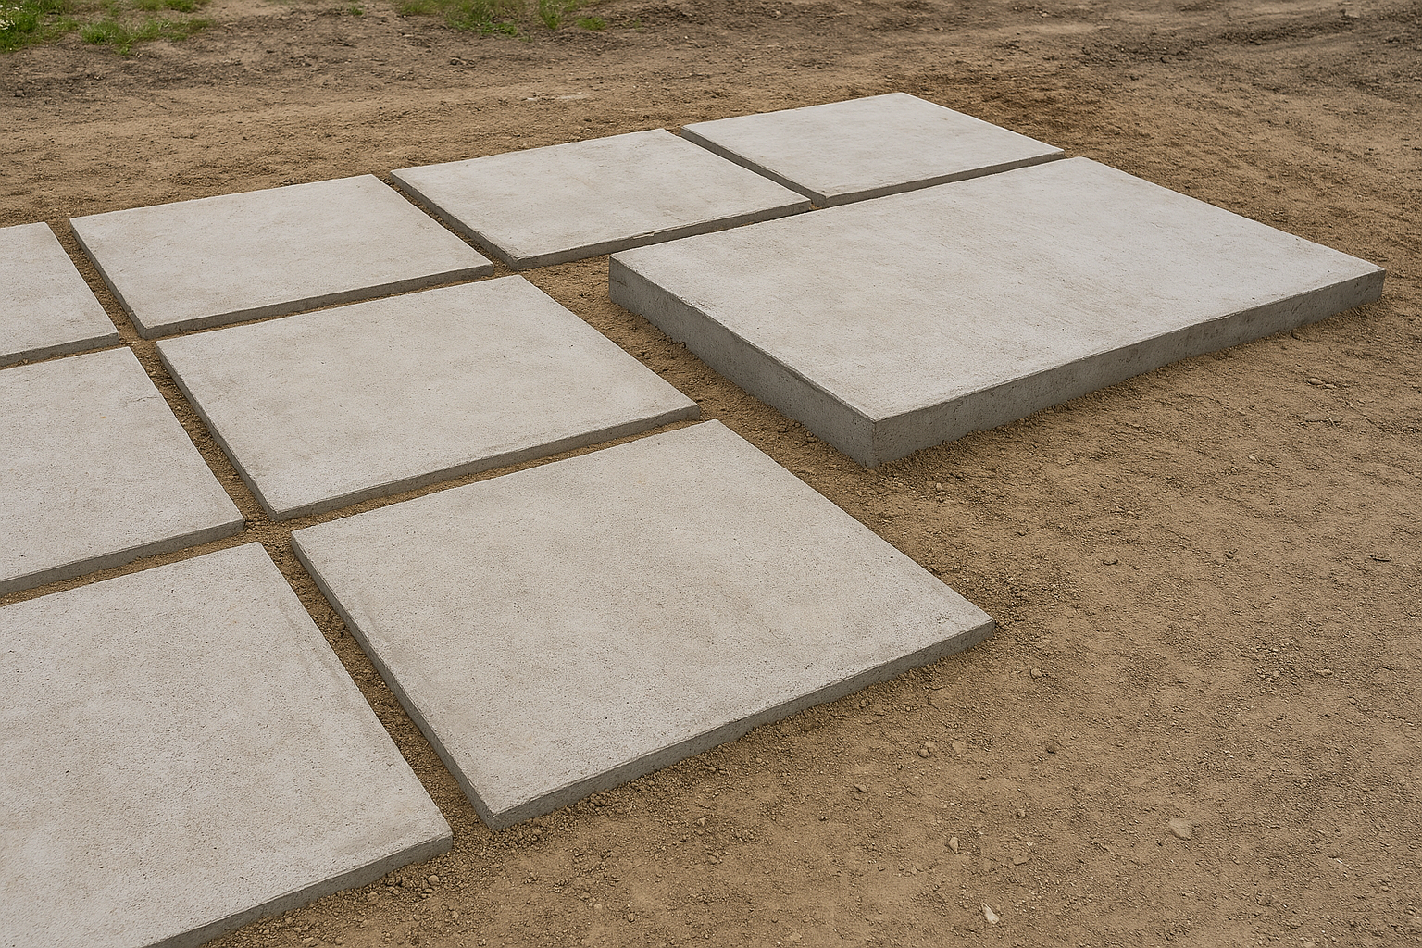
What is the problem here?
OpenAI (2026) Concrete slabs showing incorrect sizing and misalignment [Image]. Generated using AI (M365 Copilot).

Slide 24
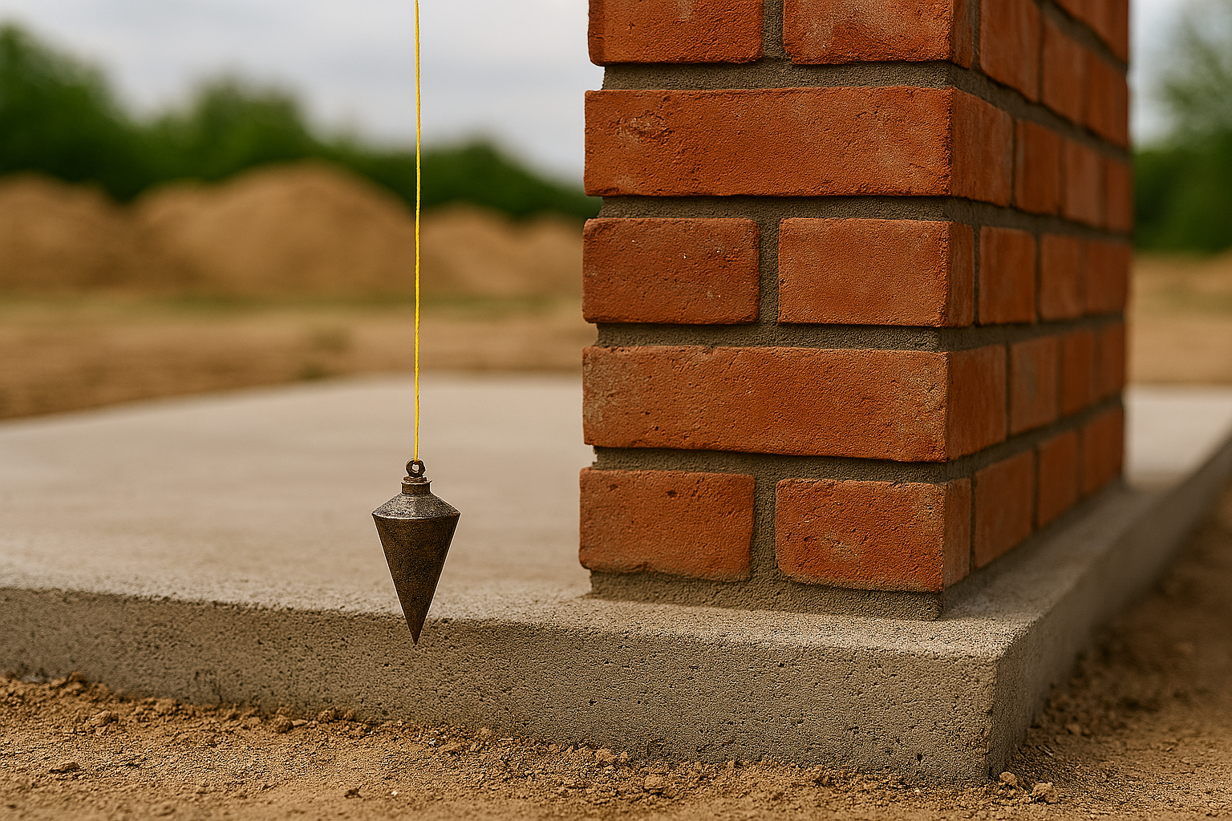
Does this look right?
OpenAI (2026) Construction use of a plumb bob for vertical alignment [Image]. AI generated.

Slide 25
Measurement terms
Accuracy – how close a measured value is to the true value.
Precision – how close together are a series of measurements.
Tolerance – the deviation allowed from a specified dimension or location.
Reliability – the reproducibility of measurements that the same value is achieved when the measurement is repeated under the same conditions.

Slide 26
Construction tolerance calculations
Individually complete the Construction tolerance calculations.
Write your answers on a mini whiteboard.

Slide 27
Compound error
A compound error occurs when multiple errors accumulate or when a single error in a chain of causes all subsequent findings to be wrong.
Individually complete the Compound error calculations.
Upload your answers to the Collaborative wall.

Slide 28
Potential consequence of errors
Over ordering.
Under ordering.
Delays.
Cost overruns.
Increased waste.
Labour costs.

Slide 29
Calculating the consequences
Individually complete the Error calculations activity.
When complete, check your answers against those in the Error calculations activity answers.

Slide 30
Types of errors
Systematic Errors: consistent, repeatable errors.
    Instrumental.
    Environmental.
Random Errors: unexpected, unpredictable variations. Often caused by uncontrollable factors, e.g. electrical noise
Gross Errors: largely human errors, such as misreading instruments, incorrect adjustments, or recording data incorrectly

Slide 31
Environment and measurement
Temperature variations (accuracy, precision): cause materials to expand or contract.
Humidity/moisture (accuracy): high humidity can lead to condensation, creating short circuits or corrosion.
Airflow and drafts (precision): causes instability.
Vibration and contaminants (accuracy, precision): vibration causes mechanical disruption; dust and dirt particles.

Slide 32
How to reduce errors
Calibration: Establishes a relationship between an instrument’s readings and a known standard – National Physical Laboratory (NPL), UK Accreditation Service (UKAS).
Repetition: Take multiple measurements to average out random errors.
Technique: Avoid parallax errors, use the manufacturer’s instructions.

Slide 33
Types of measurement tools
Spirit level.
Micrometers.
Laser scanner.
Vernier caliper.
Plumb bobs.

Slide 34
Research activity
Work in pairs.
Select one of the measurement tools.
Research the characteristics, how it works, recommended applications, benefits and limitations.
Remember to note your sources.
Complete the Measurement tools research findings table.

Slide 35
Present your findings
You will be given a slide number.
Enter your findings on your allocated slide. You can only use one slide, so think carefully about what information you include.
You will then be able to see the results of everyone else’s research.
Download the full presentation when everyone has completed their slide.

Slide 36
Which measurement tool?
Which measurement tool should be used for these situations?
To ensure that a structure is perfectly vertical.
To check that a brick course is horizontal.
To measure very small dimensions with high accuracy.
To measure 3D objects.

Slide 37
Why surveyors use precise instruments
To ensure accuracy – Provide exact measurements needed for the correct setting out of buildings and infrastructure.
To prevent costly errors – Accurate data reduces the risk of mistakes that could lead to rework, delays, or material waste.
To meet legal requirements – Surveyors must ensure boundaries and land measurements are correct to avoid disputes or legal issues.

Slide 38
What happens if we get it wrong?
Work in pairs.
Complete the What happens if we get it wrong? activity.
When complete, pass to another pair for peer review.

Slide 39
Lesson 3
Precision measurement using a total station

Slide 40
Learning aims-lesson 3
Understand the role of a total station in achieving precision measurements.
Be able to set up, use and take down a total station.

Slide 41
Lesson 3 overview
What do you need to consider when planning a site survey mind map activity in groups.
Set up a total station.
Take measurements with a total station.
Answer exam-style questions.

Slide 42
Considerations for a site survey
Work in pairs.
Create a mind map to show the factors to consider when conducting a site survey and taking measurements on a construction site.
Use flip chart paper and pens.
Then, in groups, discuss the content of the mind maps and update with additional content if needed.

Slide 43
Check out a site for a survey
Continue to work in groups.
Access the online map.
Discuss the specific factors to consider for carrying out a boundary survey on the land identified.
Update your mind map on the flip chart paper with a different coloured pen.

Slide 44
Site surveys-considerations
Access to the site – do you have permissions?
Location – where is it? How do you get there?
Conditions – weather (temperature, wind, sunlight),
Potential obstructions and barriers (e.g. trees, utilities (overhead lines), surrounding buildings, other people (employees, site workers, users, visitors, animals), terrain (slopes, water)

Slide 45
Why use a total station?
Combines distance measurement, angle measurement, and data recording.
Applications:
Site layout.
Topographic surveys.
Control points.
Benefits:
High precision.
Efficiency.
Integration with digital models.

Slide 46
Health and safety
Hazards:
Trip hazards from tripod legs.
Manual handling injuries.
Laser eye safety.
Working near traffic or machinery.
Control Measures:
PPE (hard hat, hi-vis, boots).
Correct lifting techniques.
Positioning equipment safely.
Follow laser safety guidelines.

Slide 47
Observe how a total station set up
Work in pairs.
Follow the demonstration and set up your total station.

Slide 48
Set up your total station
Take turns.
One of you sets up the total station. The other takes a health and safety role, ensuring each state is secured before moving to the next stage.
Shut down the total station once you have set it up.
Swap roles and set up the total station again.

Slide 49
Importance of correct set up and levelling
Ensures accurate measurements.​
Prevents cumulative errors​.
Ensures proper alignment​.
Maintains tolerance limits​.
Improves safety​.
Saves time and costs.

Slide 50
Observe how to take measurements with a total station
Work in pairs.
Follow the demonstration.

Slide 51
Take measurements with a total station
Take turns taking measurements of the four corners of a window.
Aim at the target point.
Focus the lens for sharpness.
Click ‘measure’ for the machine to take the measurement.
When one is taking the measurement, the other records the on- screen measurement on the Template to record survey measurement.

Slide 52
Measuring in an external environment
We will be going outside to use the total station. Be prepared!
Consider:
Health and safety.
What you should wear.
Bring pens and notebooks.
How the environment might affect measurement.

Slide 53
Lesson 5
Problem-solving using total station data

Slide 54
Learning aims-lesson 5
Be able to solve construction problems using total station data.

Slide 55
Lesson 5 overview
Consider any difficulties encountered using the total station outside.
Use Excel to create an image of coordinates from the measurement data.
Individually carry out a range of calculations to solve construction problems.
Discussion on the ‘what if?’ scenario.

Slide 56
Any difficulties working with the total station in the external environment?
Go to the Collaborative wall.
Work individually.
Write two difficulties you encountered when using a total station in the external environment.

Slide 57
Using Excel
Open a new Excel workbook or open your Excel homework and create a new worksheet. Save it with an appropriate file name.
Watch the demonstration of how to use Excel to plot coordinates, using measurement data.
Input the same information as you follow the demonstration.

Slide 58
Solve a problem
The construction company has been commissioned to apply cladding to the building you measured.
You need to calculate how much cladding is needed.
They also need to know how much storage space will be needed for the cladding.
We will go through the process step-by-step.

Slide 59
Perimeter
Use the data you entered into Excel for homework.
Using what you learned from the earlier demonstration, plot the coordinates and calculate the perimeter of the building.
Your results will be shared on the whiteboard.

Slide 60
Area
Area = length x width. The result is always expressed in square units, e.g. 20m²
Calculate the following:
Area of the building façade.
One window.
The door.

Slide 61
Cladding
You have been given the cladding measurements.
Now that you have all the information you need, you can calculate the area of cladding required.
Remember, the cladding is not needed for any of the windows or doors.

Slide 62
Poll
Go to the Poll application.
Work individually.
Select the value on the poll that is closest to the answer you calculated for the cladding.

Slide 63
Volume
To calculate the volume of a 3D object, multiply the area of its base by its height. Volume is expressed in cubic units, e.g. m³.
The construction company needs to store the cladding. Calculate the volume of space needed to store the cladding.
Put your answer on a mini whiteboard.

Slide 64
Question
How would the calculations be different if one corner of the building was slanted?
Discuss in pairs before we discuss as a class.

Slide 65
Next lessons
For the next set of lessons, we will be continuing to use the total station to measure the built environment and collect data.
We will also be carrying out calculations to solve construction problems.
We will use trigonometry for the calculations.

Slide 66
Lesson 6
Site survey

Slide 67
Learning aim-lesson 6
Be able to collect data through measurement to solve problems.

Slide 68
Lesson 6 overview
What is trigonometry?
Trigonometry calculations.
Physical site survey using a total station.

Slide 69
Starter
On Mentimeter, write three words associated with trigonometry.

Slide 70
Key trigonometry terms
Sine.
Cosine.
Tangent.
Hypotenuse.
Angles.

Slide 71
Using trigonometry to work out length
Add the following values and labels to your triangle diagram:
Hypotenuse 9584mm.
Opposite.
Adjacent.
Angle 30⁰.
Right angle.
Each vertices A, B, C.

Slide 72
Calculate length with the sine rule
sin θ = opposite
hypotenuse
sin 30⁰ = opposite = BC
9584mm 9584mm
BC = 9584 mm x sin 30⁰
= 4792 mm x length of strut BC

Slide 73
Calculate length with the cosine rule
sin θ = adjacent
hypotenuse
cos 30⁰ = adjacent = AC
9584mm 9584mm
AC = 9584 mm x cos 30⁰ = 8300mm

Slide 74
Calculate an angle using trigonometry
tan θ = opposite
adjacent
tan θ = 4792mm = 0.44873
10679mm
Tan⁻¹ (0.44873) = 24.1672 decimal degrees
= 24⁰ 10’

Slide 75
Triangles without right-angles
A triangle without a right angle has no hypotenuse.
All angles are labelled with capital letters (A,B,C).
All sides are given lowercase letters (a, b, c).

Slide 76
Non-right-angle triangle sine rule
a = b = c
sin A sin B sin C
a = b or b = c
sin A sin B sin B sin C
or even a = c
sin A sin C

Slide 77
Non-right-angle triangle cosine rule
The cosine rule states that
A² = b² + c² – 2bc cos A or
B² = a² + c² – 2ac cos B or
C² = a² + b² – 2ab cos C

Slide 78
Trigonometry calculations
Individually, complete the calculations on the Trigonometry refresher.

Slide 79
Site survey
We are now going to a site to carry out a survey.
Consider health and safety when on site.
Wear your PPE.

Slide 80
Site survey sketch
You will work in groups of three.
First, you will each sketch the site so that you have your own.
In your groups, discuss the data points to be measured. Add these to your individual sketch.
Compare your sketches and then check against the Physical site survey sketch you will be given.

Slide 81
Carrying out the site survey
In your groups of three, you will each take turns collecting the data. For each data point, there will need to be:
One learner using the total station to measure the data point.
One learner ensuring the total station has been correctly calibrated and to record the data collected.
One learner to hold the prism.
When all measurements are completed, transfer the data to the shared area.

Slide 82
Need help?
Refer to the How to set up a total station handout.
Use the Template to record data.
Don’t forget to upload your data and pack away the total station at the end.

Slide 83
Plot the boundary shape in Excel
Open an Excel Worksheet titled Boundary Survey – Your Name.
Follow the demonstration.
In the Worksheet, create a table with two columns: Easting (x), Northing (y).
Input your data into the table.
Produce your boundary shape.

Slide 84
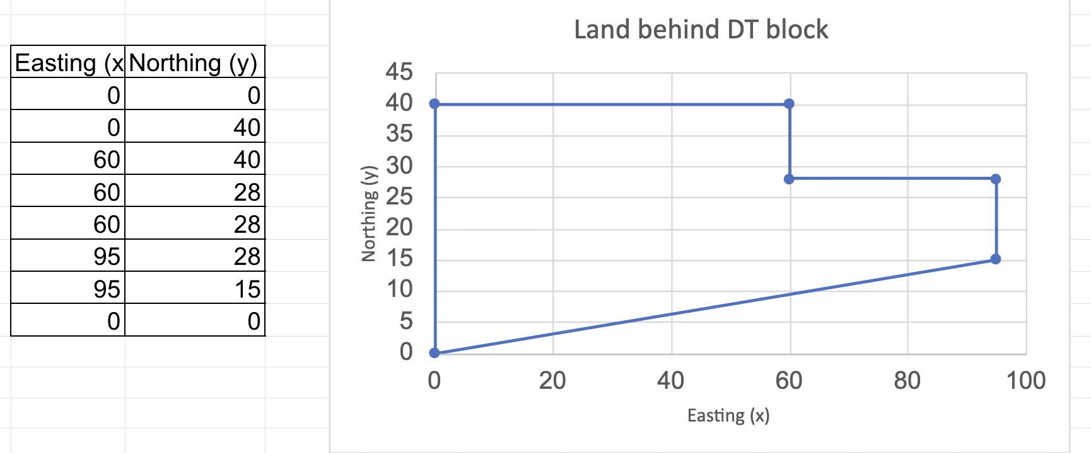
Example of outcome

Slide 85
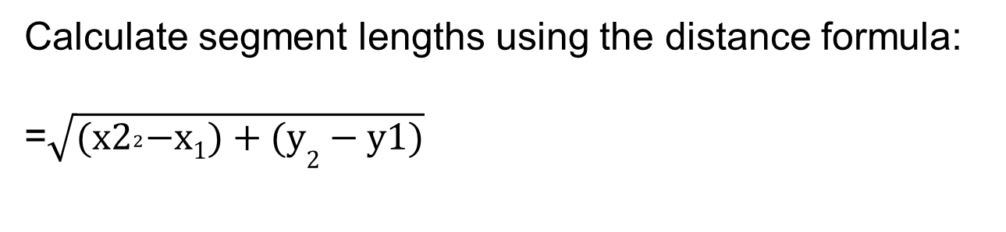
Calculating boundary (perimeter) of the site
Calculate segment lengths using the distance formula:
=$\sqrt{{(x2}^{2}−x1)+(y2−y1)}$

Slide 86
Homework-lesson 6
Look back at your Excel workbook.
Is there anything that isn’t clear? Be prepared to ask clarification questions in the next lesson.

Slide 87
Lesson 7
Solving construction problems with trigonometry

Slide 88
Learning aim-lesson 7
Be able to apply trigonometry to solve construction problems.

Slide 89
Lesson 7 overview
Working with total station data readings.
Trigonometry exercises.
Working from a map view.
Calculating roofing materials.

Slide 90
Refresher – total station data
Look at the total station data readings activity sheet.
Individually complete the exercises.
When complete, you will discuss your answers with another learner.

Slide 91
Applying trigonometry to calculate area
Area=1/2 a x b sin(C)
Where:
a and b are two sides of a triangle
c is the angle between them
a
c
b

Slide 92


Example to calculate area
Area = 1/2​×5×7×sin(${30}^{0}$)
= 17.5×0.5=8.75
A=5
$${30}^{0}$$
B= 7

Slide 93
Solving construction problems using trigonometry
Look at the Applying trigonometry to calculate area.
Individually complete the exercises.
When complete, check against the answers provided.

Slide 94
Aerial view sketch activity
Work in groups.
Discuss the calculations you need to make to solve the construction problem.
Carry out the calculations needed.

Slide 95
How many tipper trucks?
Look at your Aerial view sketch.
You now need to stay in your groups and calculate how many tipper trucks are needed.

Slide 96
Roofing activity
Individually read the information on the Roofing activity sheet.
Now, determine the amount of materials needed. Use the previous exercises to help you to plan your approach.
Hand in the completed Roofing activity document.

Slide 97
Lesson 8
Measurement for a retrofit

Slide 98
Learning aim-lesson 8
Be able to apply mathematical techniques to solve construction problems

Slide 99
Lesson 8 overview
Risk assessment activity.
Calculate the amount of cladding needed for a retrofit using Excel.
Site measurement with a total station.

Slide 100
Risk assessment terminology
Hazard.
Severity/impact.
Probability/likelihood.
Control measures.
Risk.

Slide 101
Risk assessment scenario
As part of a refurbishment project for a dockside industrial building, external measurements of the pitched roofs are needed. This includes measuring the building footprint, roof pitch, ridge height, and rafter lengths.
The work area includes roof edges, a dockside water hazard, vehicle access routes, and elevated working positions.

Slide 102
Cladding scenario data
Individually review the Cladding scenario data.
Use Excel to calculate the amount of cladding materials to be ordered.
Enter your answers into Mentimeter.

Slide 103
Preparing for a site survey
You will work in groups of three.
Discuss the data points to be measured.
Individually sketch the site, including the data points you agreed on.

Slide 104
Checking the validity of data through a site survey
In your groups of three, you will each take turns collecting the data, as you did in an earlier lesson.
When all measurements are completed, transfer the data to the shared area and put away the total station.

Slide 105
Quantity of materials required
Individually calculate the quantity of materials required.
Use the data you have collected in your groups.
Use Excel to carry out the calculation.

Slide 106
Compare the data
Individually calculate the difference in the quantity of materials required based on the two sets of data.
Hand in your calculations.

Slide 107
Lesson 9
Using AI to support decision making

Slide 108
Learning aims-lesson 9
Be able to obtain information using AI.
Be able to carry out complex calculations.
Be able to justify a proposal.

Slide 109
Lesson 9 overview
Have you used AI before?
Using AI to obtain useful information about wind turbines.
Justifying a proposal to install wind turbines.
Carry out calculations.

Slide 110
Artificial intelligence (AI)
What is your experience of using AI?
Write on your mini whiteboards.

Slide 111
Using AI to obtain information
Follow the process being followed to obtain information about a risk assessment for an excavation.

Slide 112
Referencing sources
Plagiarism is using someone else’s ideas or words and presenting them as your own. Often not intentional, but credit to the original is not given.
To avoid plagiarism, sources must be referenced. To avoid accusations of plagiarism.

Slide 113
Harvard referencing of a website
Author Surname, Initial. (Year Published) 'Page Title', Website Name, Available at: URL (Accessed: Day Month Year)
Example
Health and safety executive (2026) Health and safety basics for your business, Available at https://www.hse.gov.uk/simple-health-safety/risk/risk-assessment-template-and-examples.htm (Accessed: 25 May 2026)

Slide 114
Harvard referencing of AI
Format: Company Name. (Year) Name of AI (Version if known). [Generative AI]. Day/month accessed. Available from: URL or shareable link (if available).
Example
OpenAI. (2026) ChatGPT (Version 4.0). [Generative AI]. Accessed 15 May 2026. Available from: openai.com

Slide 115
Wind turbines case study
Work in pairs.
Carry out research using AI to find information on wind turbines that would be useful to help the farmer decide what to do.
Complete the Research log with your findings and sources.

Slide 116
Justify
Justify means to use evidence to show how a proposal would resolve an issue or meet an objective.
Key terms that can be included when justifying:
As shown by...
A compelling reason is...
Based on the data collected...
This position is based on…
This is corroborated by …
Evidence clearly indicates that….

Slide 117
Example justification
A developer is looking to install solar panels on a brownfield site. Justify how it supports sustainability.
The proposal makes effective use of underutilised or previously developed land. Brownfield sites are often vacant, contaminated, or unsuitable for housing or agriculture. Installing solar panels allows the land to be repurposed productively without requiring extensive new development elsewhere. This aligns with planning policies that prioritise sustainable land use and redevelopment.

Slide 118
Now you justify
Work individually.
Will the cows be affected by the installation of wind turbines in the fields where they graze?
Answer the question, justifying your response.

Slide 119
Which calculation first?
Review the information in the Wind turbines case study.
Work in pairs.
Discuss the calculations needed to find an answer to the problem in the case study.
Agree on the order in which the calculations should be completed.

Slide 120
Solve the problem
Work individually.
Carry out the calculations in the order that has been agreed.

Slide 121
Check your answers
Review your answers against those on the Wind turbine calculations answers.
Note any errors and misunderstandings.

Slide 122
New problem
During the installation of a wind turbine, a temporary support cable needs to be attached from the top of the turbine tower to the ground to hold it steady. The cable forms a right-angled triangle with:
The height of the turbine tower.
The horizontal distance from the base.
Given information:
Height of turbine tower = 80 m.
Angle between the cable and the ground = 53°.

Slide 123
New calculation exercise
Calculate the length needed for the support cable.
Calculate how far from the base the cable should be anchored.
Justify whether the distance from the base to the anchor is safe.

Slide 124
Report to the farmer
Produce a report for the farmer with recommendations based on all the information you have.
Justify your recommendations.
Pass the completed report to peers for review.

Slide 125
Peer review the report
Read through the report you have been given.
Review the justification.
Was it well reasoned?
Was it objective?
Was it evidence-based?
Give constructive comments and return to the original pair.

Slide 126
Are wind turbines good or bad for a local community where they are located?
Based on your own view, move to the relevant part of the room.
If you are undecided, go into the centre.
Be prepared to justify your choice.

Slide 127
Next steps for lesson 10
In the next lesson, you will be given a new case study.
You will need to plan how to conduct the measurements needed. You will use a total station to collect data. You will then use the data to solve a problem and make justified, evidence-based recommendations to a client.
Go through all your notes for the previous lessons to help you to prepare.

Slide 128
Lesson10
Solar panel installation

Slide 129
Learning aims-lesson 10
Be able to measure the built environment.
Be able to use data to solve a problem.

Slide 130
Lesson 10 overview
Read the case study.
Use AI to carry out research.
Plan for the measurement of data and peer review plans of others.
Measure the built environment.
Make a justified and evidence-based proposal for action.

Slide 131
Case study introduction
You have been given the Solar panel installation case study. Read this carefully.
As you read:
Identify any terms you do not understand.
Highlight key points.
Ask for clarification where needed.

Slide 132
Your task
Work individually.
Use AI to research solar panels and related information needed to assist you in solving the problem in the case study. Complete the Research log.
Use the information to plan the stages to follow so that you can propose a solution to the problem in the case study. Ensure you justify your plan. Complete the Planning template.

Slide 133
Peer review of the plan
Review the plan that you have been given.
Highlight any issues with the plan.
Annotate with constructive comments.
Ensure you comment on the quality of the justification.

Slide 134
Plan revision
Read through your feedback.
Ask questions if anything is not clear.
Compare your plan with the feedback and make changes to your own plan that are needed.

Slide 135
Measure the environment
Work in pairs.
Move to the site.
Carry out measurements needed.
Record the data collected.
Ensure that each of you takes on the measurement role and the data recording and verifying role.

Slide 136
Carry out the calculations
Work individually.
Carry out the calculations required using the data you collected.
Produce a short report to the owner of the building with a proposal and justification of the proposal.
Hand in your completed outputs to the teacher.

Slide 137


Acknowledgements
PRODUCED BY
FUNDED BY
London Design & Engineering UTC has produced this resource on behalf of the Education and Training Foundation
This programme is funded by the Department for Education
ET-FOUNDATION.CO.UK

