Slide 1
Post-16 Pathways: Implementation Plan and Strategic Transition Planning Statement
Technical and Vocational Qualifications Directorate, Department for Education
June 2026

Slide 2
Contents
16-19 Pathways implementation plan
Strategic Transition Planning Statement
Help and support
Questions

Slide 3
Post-16 pathways: implementation plan
Published Wednesday 20 May 2026
For everyone involved in the planning or delivery of 16 to 19 study programmes.

Slide 4
Context
Curriculum and Assessment Review recommended a third pathway at level 3 (V Levels), two new level 2 pathways (Occupational and Further Study), and new 16–19 level 1 English and maths stepped qualifications.
Post-16 Education and Skills White Paper committed to these and subsequent consultation.
Post-16 Pathways Consultation contained detailed proposals

Slide 5
Context (continued)
Post-16 pathways: government response
Published Tuesday 10 March 2026
Sets out approach to new pathways at L3 and below
How we will support transition

Slide 6
16-19 Pathways Overview
Apprenticeships | Level 2 | Further Study (Foundation Certificates ) For students who want, and are capable of, further study on a level 3 pathway, whether T Levels, V Levels or A levels, after an additional year at level 2. Strong focus on English and maths, alongside other enrichment activity and exposure to level 3 study. Includes a Foundation Certificate of 240-300GLH providing a balance of breadth and depth in a broad vocational area, with content set nationally. Foundation Certificates focus on applied and practical learning, with content aligned to the level 3 options they support progression onto. | Occupational (Occupational Certificates) For students who want to enter a particular level 2 occupation and need to develop their technical knowledge and skills in a classroom-based setting, with the aim of progressing into skilled employment in relevant level 2 roles. Tailored to support progression to work, including employability and enrichment activity. Strong focus on English and maths . 2 year pathway aligned with the new level 1 English and maths qualification in the first year for students with lower prior attainment. Includes an Occupational Certificate, with broad, nationally set introductory content based on the occupational standard, as well as nationally mandated occupation specific content. Size of the Occupational Certificate is driven by the relevant occupational standard and will be between 540 and 720GLH.
 | Level 3 | Vocational (V Levels) Provide broad, vocational qualifications for students who wish to explore a range of sectors without specialising. Two-years duration, 360 GLH so can be studied alongside other V Levels or A levels to form broad programmes. Blends applied learning and practical assessment with core knowledge and understanding - content is linked to occupational standards set by Skills England. Enable progression to related higher education, or an apprenticeship. | Technical and Occupational (T Levels) The technical and occupational pathway for students who know which broad career area they want to pursue. A single, large qualification equivalent to three A levels. Aligned to employer-based standards. Include a 45-day industry placement. Combine sector-specific core content with a specialist component that develops competence in an occupation. Enable progression to related higher education, apprenticeships, or skilled employment. | Academic (AS/ A levels)

Slide 7
2026 Implementation Timeline
Early summer 2026:
Subject content consultation for 2028 T Levels will be open for 6 weeks
June 2026:
Subject content consultation for 2027 V Levels, Foundation Certificates and Occupational Certificates closes
July 2026:
  Subject content published for 2027 V Levels, Foundation Certificates and Occupational Certificates
  Final list of 2027 V Levels, Foundation Certificate and Occupational Certificate subjects and subject titles confirmed
  Ofqual consultation on assessment and grading closes
  Strategic Transition Planning Statements due - 6 July 2026
Autumn 2026:
Subject content published for 2028 T Levels
Final list of 2028 T Level subjects and subject titles confirmed
Accreditation and approval submissions to Ofqual and the Department for Education (DfE) for 2027 V Levels, Foundation Certificates and Occupational Certificates
Funding approval is extended into 2027 to 2028 for qualifications that continue to be eligible
September 2026:
    Example progression pathways for 2027 V Levels published
    Ofqual publishes its regulations for V Levels, Foundation Certificates and Occupational Certificates
    DfE publishes funding approval information for V Levels, Foundation Certificates and Occupational Certificates, including where applicable technical qualification approval
    Draft qualification specifications start becoming available for 2027 V Levels, Foundation Certificates and Occupational Certificates
  November 2026:
Content consultation for 2028 V Levels, Foundation Certificates and Occupational Certificates will launch
December 2026
Content consultation for 2028 V Levels, Foundation Certificates and Occupational Certificates closes

Slide 8
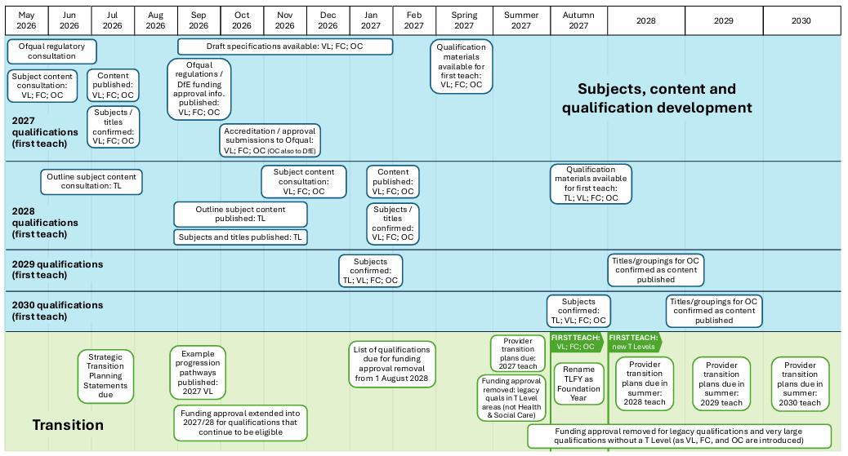
Implementation Timeline (continued)

Slide 9
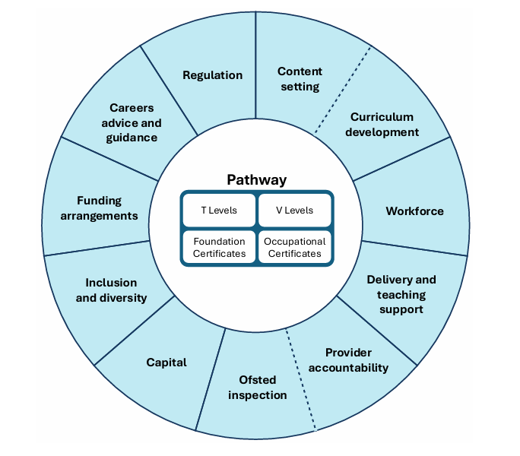
National policy environment

Slide 10
Funding and transition
Public funding approval will be removed from existing 16-19 qualifications as new qualifications are introduced
Providers are expected to transition to T Levels, then V Levels and reformed Level 2 qualifications from 2027
No qualifications will have funding approval removed in 2026-27 academic year to maintain stability during transition
Funding will continue for Foundation for Learning and Life and Preparation for Life qualifications until EEP provision is revised

Slide 11
Funding and transition (continued)
From 2027, funding approval will be removed from most legacy Level 3 qualifications in Digital, and Accounting and finance
Funding will also be removed from most legacy Level 2 and 3 qualifications in:
    Child development and well‑being
    Teaching and lecturing
    Direct learning support
From 2027-28, funding will be removed from legacy Level 3 qualifications (1,080 GLH+) in existing T Level subject areas
Large health and social care qualifications will be removed later, from 2028-29, alongside the new T Level in social care

Slide 12
How we're working with the sector
Qualification Pioneers
TVQ Stakeholder Steering Group
Subject Development and Review Groups
Sector engagement on subject scoping and development.
T Level Delivery Group
Level 2 and Below Systems Design Working Group
Technical and Vocational Qualifications (TVQ) HE Network
Stakeholder engagement events held alongside the consultation on Level 1 English and maths qualifications
Stakeholder engagement activity alongside the consultation on 16-18 Performance Measures
The DfE Regional and Further Education Teams will engage with colleagues across schools, academies, colleges, private training providers, and others to capture local insight throughout the year to inform delivery and roll out.

Slide 13
Strategic Transition Planning Statement
For every 16-19 institution in England

Slide 14
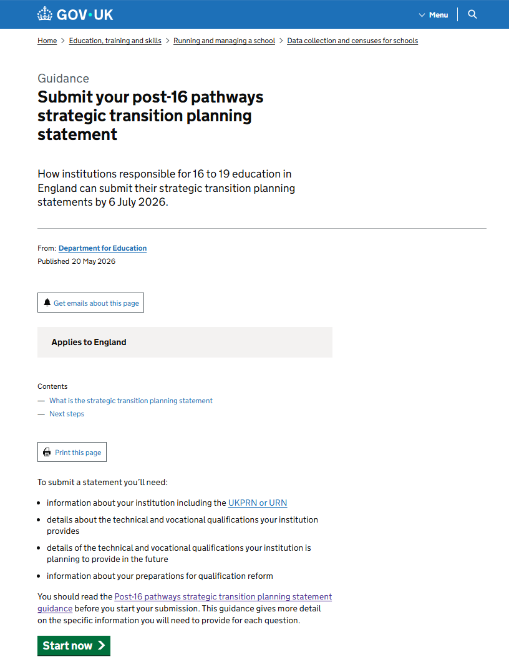
Strategic Transition Planning Statement
Submit your post-16 pathways strategic transition planning statement - GOV.UK

Slide 15
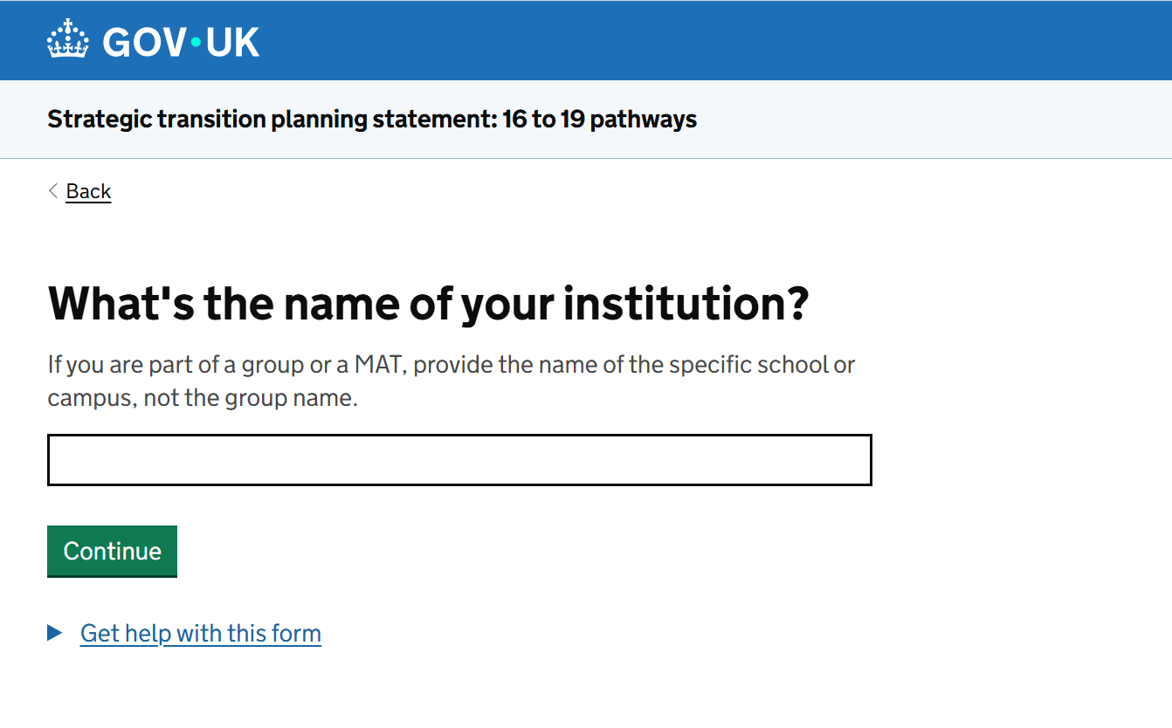
Strategic Transition Planning Statement
You should submit an STPS via the Department’s online portal by 6 July 2026.

Slide 16
Questions in the STPS
1. Provider details
2. Does your institution currently deliver, or plan to deliver, applied, technical or vocational qualifications in the next 3 years?
3. At level 3 this includes qualifications categorised as technical, applied general or occupational within performance tables.
3. T Levels.
4. Delivery of other Level 3 Pathways including V Levels.
5. Delivery of reformed Level 2 Pathways - Level 2 Further Study Pathway and Occupational Pathway.
6. Challenges with transition and preparedness.
7. Communications and marketing of qualification offer.
8. Confirmation of sharing with CEO/Chair of governing body and expectation of Board of Governors’ engagement.

Slide 17
Frequently Asked Questions (FAQ)
Do I need to submit a STPS if I’m not planning to deliver vocational/ technical qualifications?
What if I don’t know / have enough information to make decisions at this stage?
Can I change my answers later on? Will I be held to account for this?
What will the STPS be used for by the Department?
Do I have to agree to AI being used to analyse my responses?
Can I see the full set of questions and guidance before/after submitting?
If my organisation has one UKPRN but multiple sites, can we submit more than one form?

Slide 18
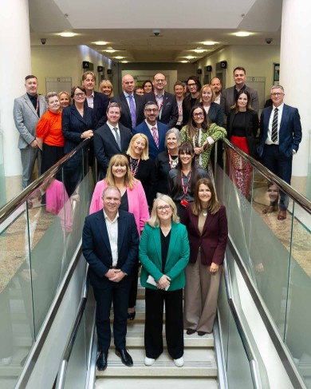
Qualification Pioneers
Working in partnership to influence and shape implementation
Significant operational experience of curriculum, workforce, finance, careers guidance, learner support, and employer engagement
Test and challenge so that what is implemented is practical, proportionate, and deliverable
Diversity of expertise is a real strength
Insight shaping guidance, transition materials, and accountability arrangements that genuinely support

Slide 19
Events
Post 16 Level 3 and below qualification pathways events – to get ahead of planning, transition and readiness to deliver from the 2027 to 2028 academic year.
North Tuesday 30 June 2026
City of Liverpool College - 10:00–14:30
https://www.aoccreateevents.co.uk/aoc/3402/register
Midlands Wednesday 1 July 2026
BMet – Matthew Boulton College - 10:00–14:30
https://www.aoccreateevents.co.uk/aoc/3403/register
South Thursday 2 July 2026
Southwark College - 10:00–14:30
https://www.aoccreateevents.co.uk/aoc/3404/register

Slide 20
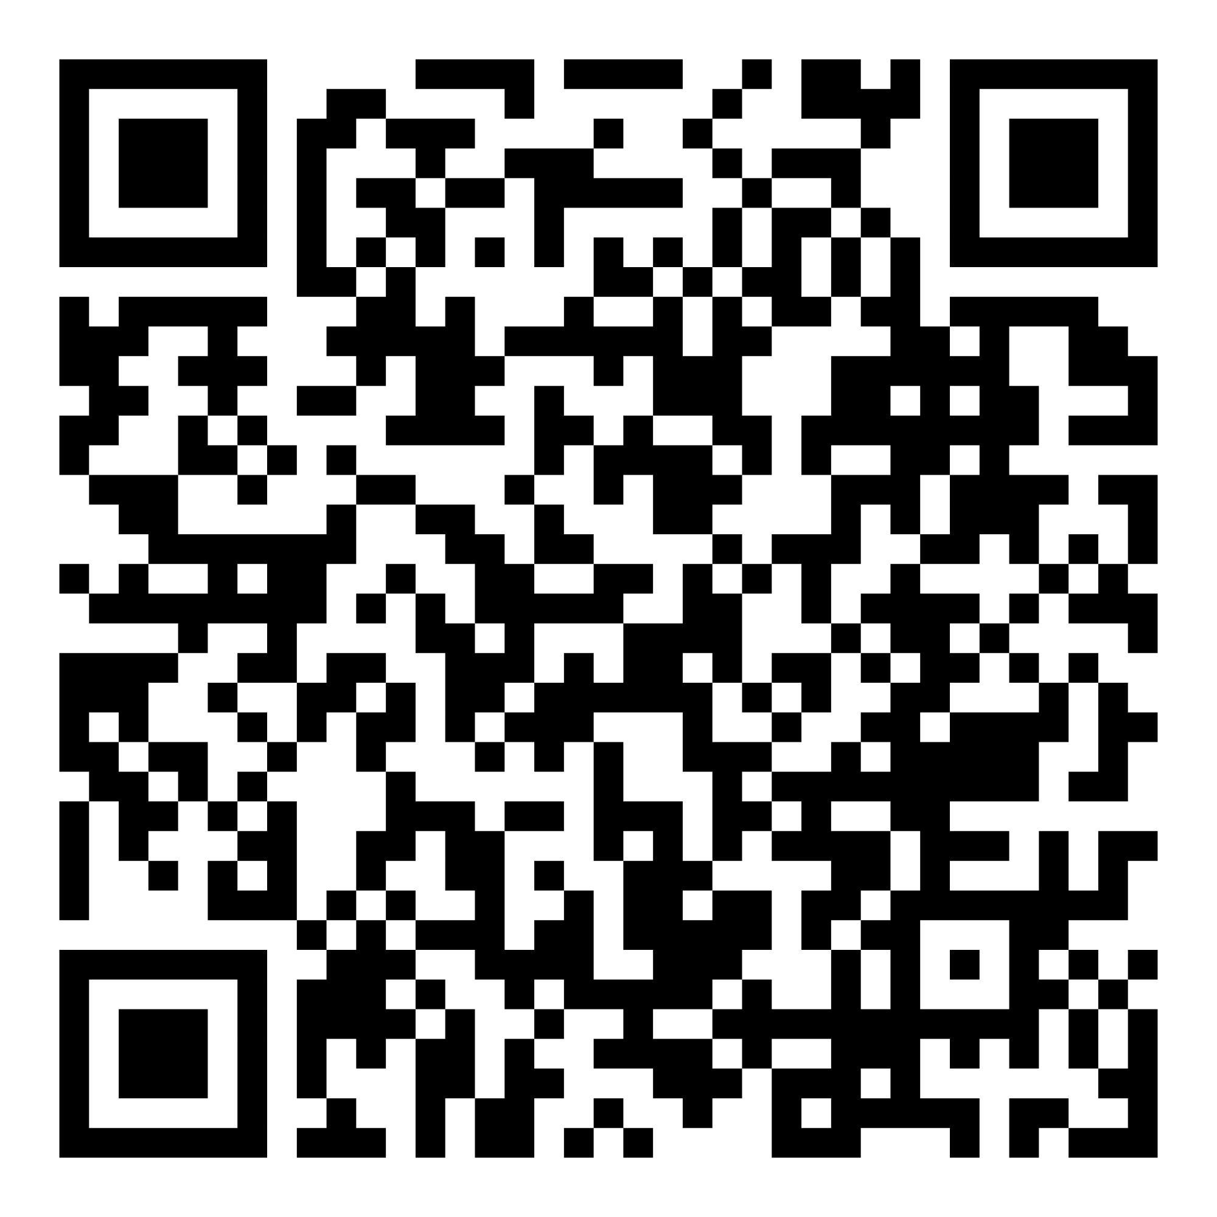
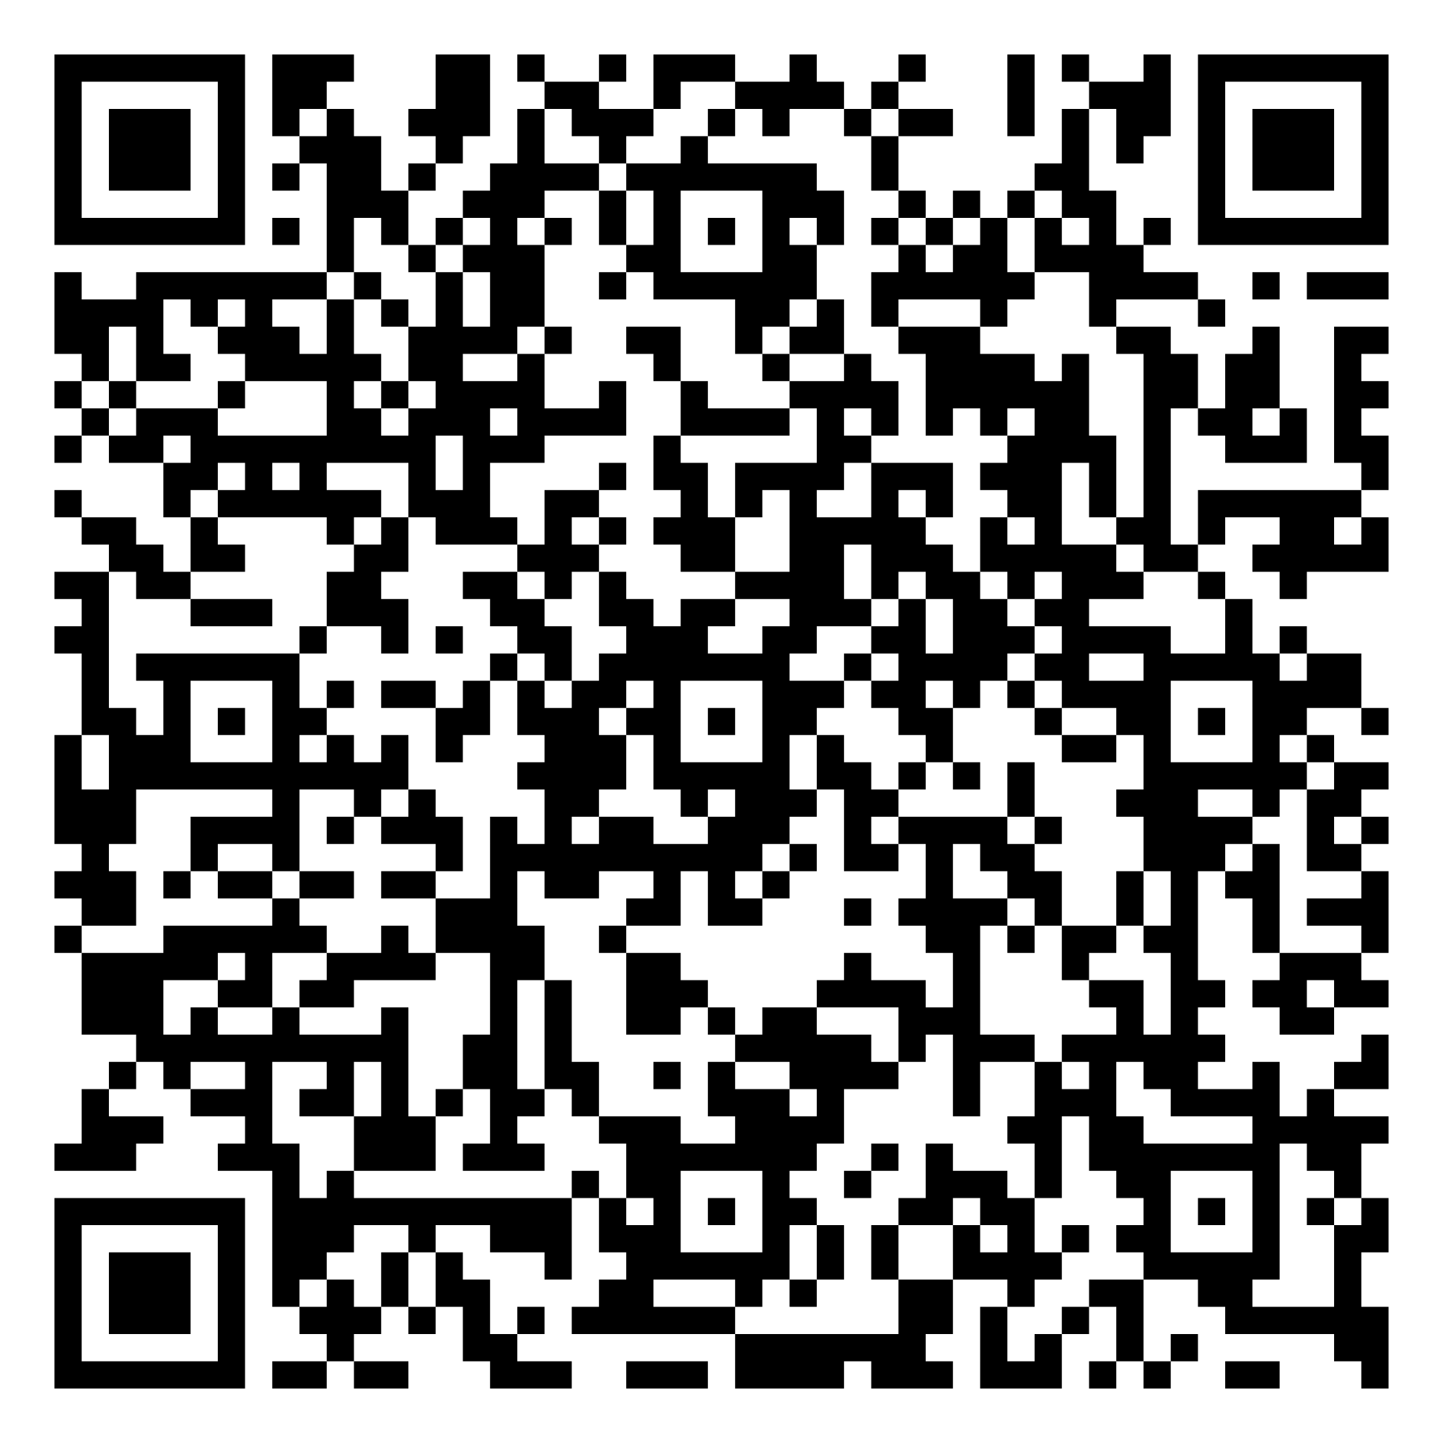
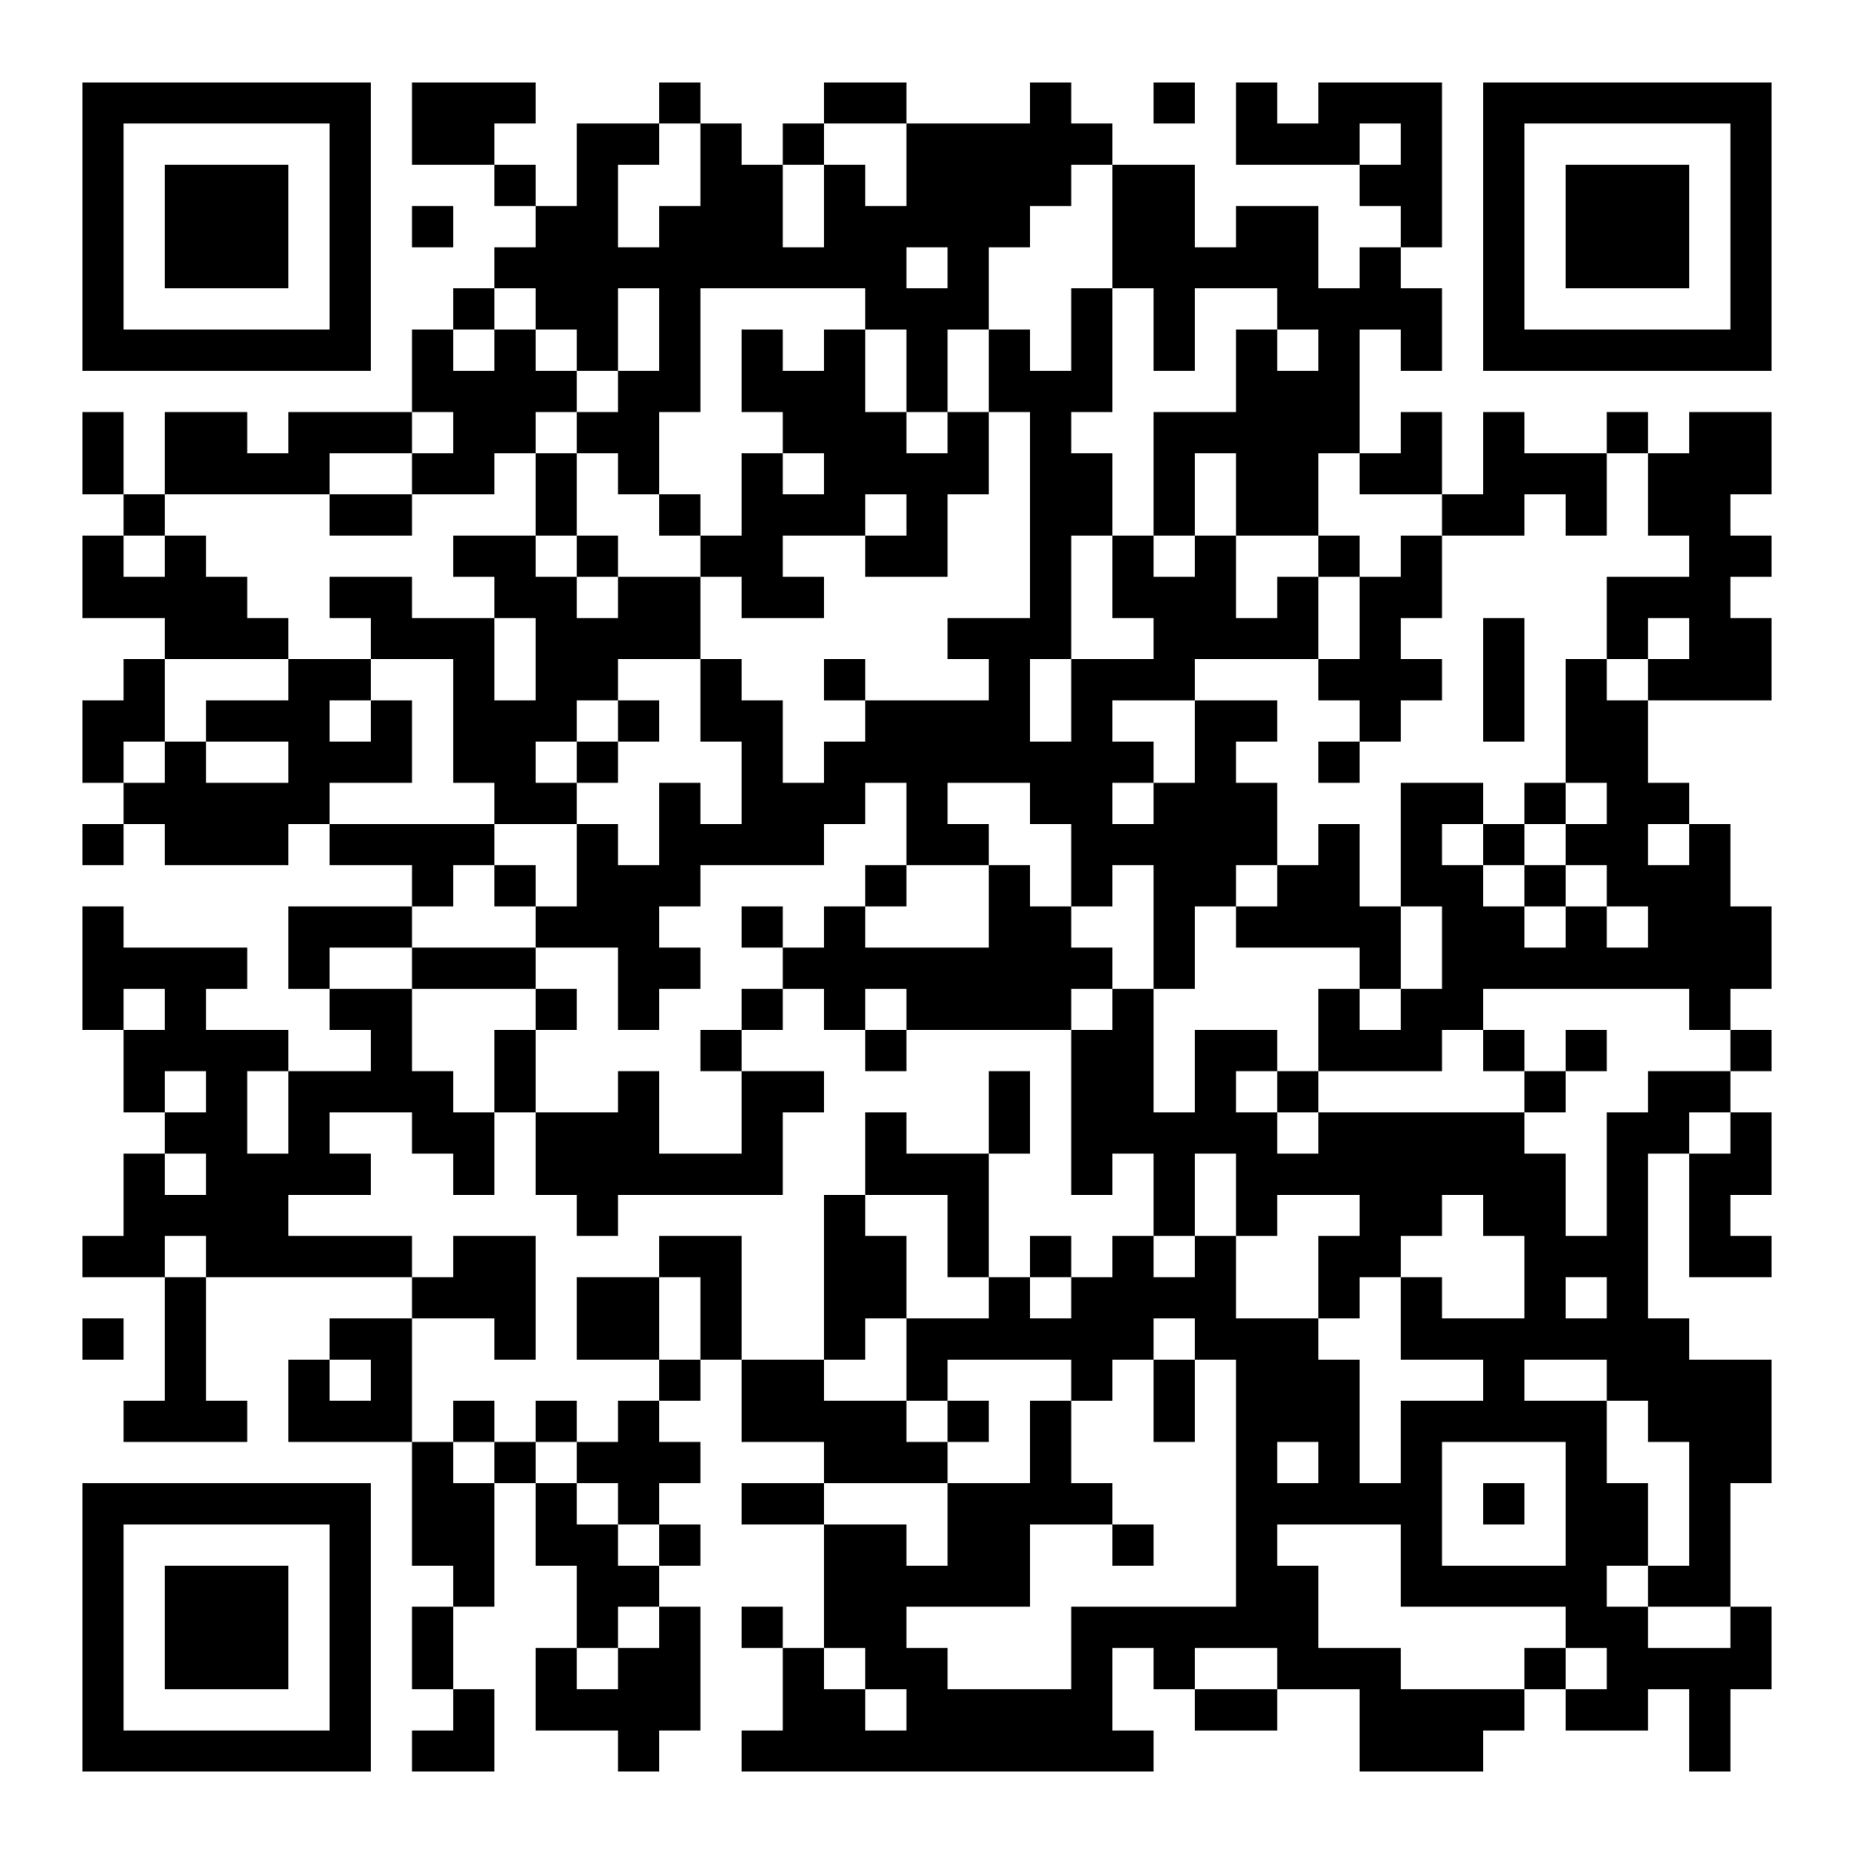
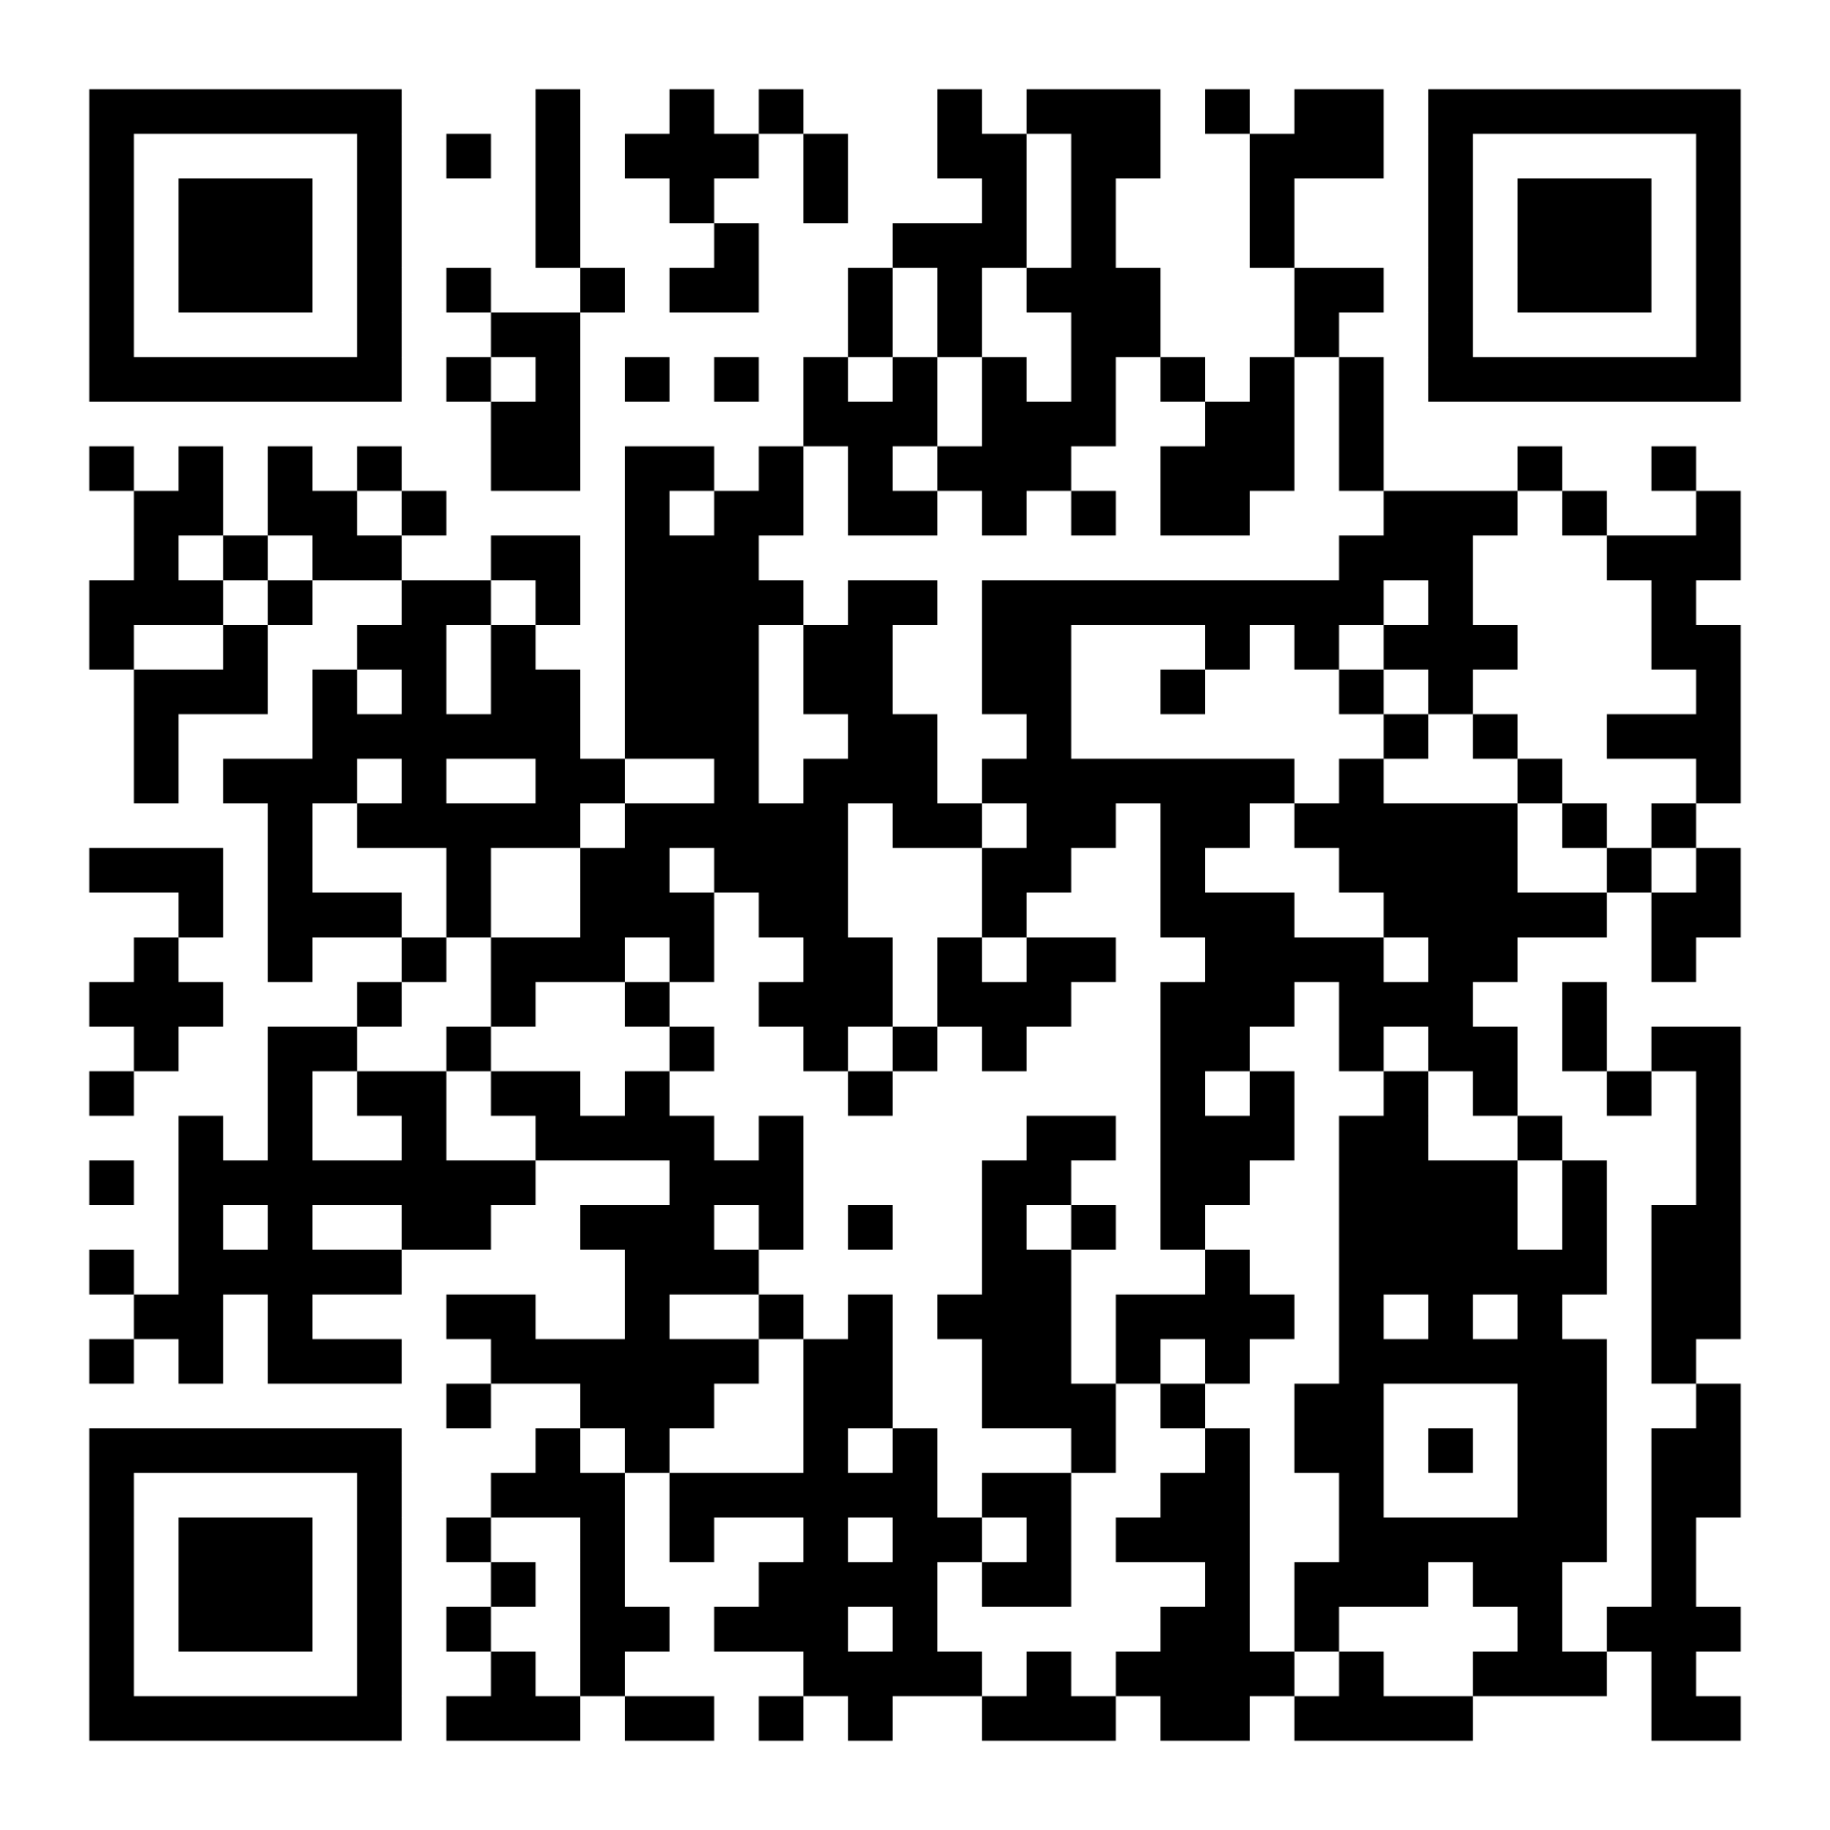
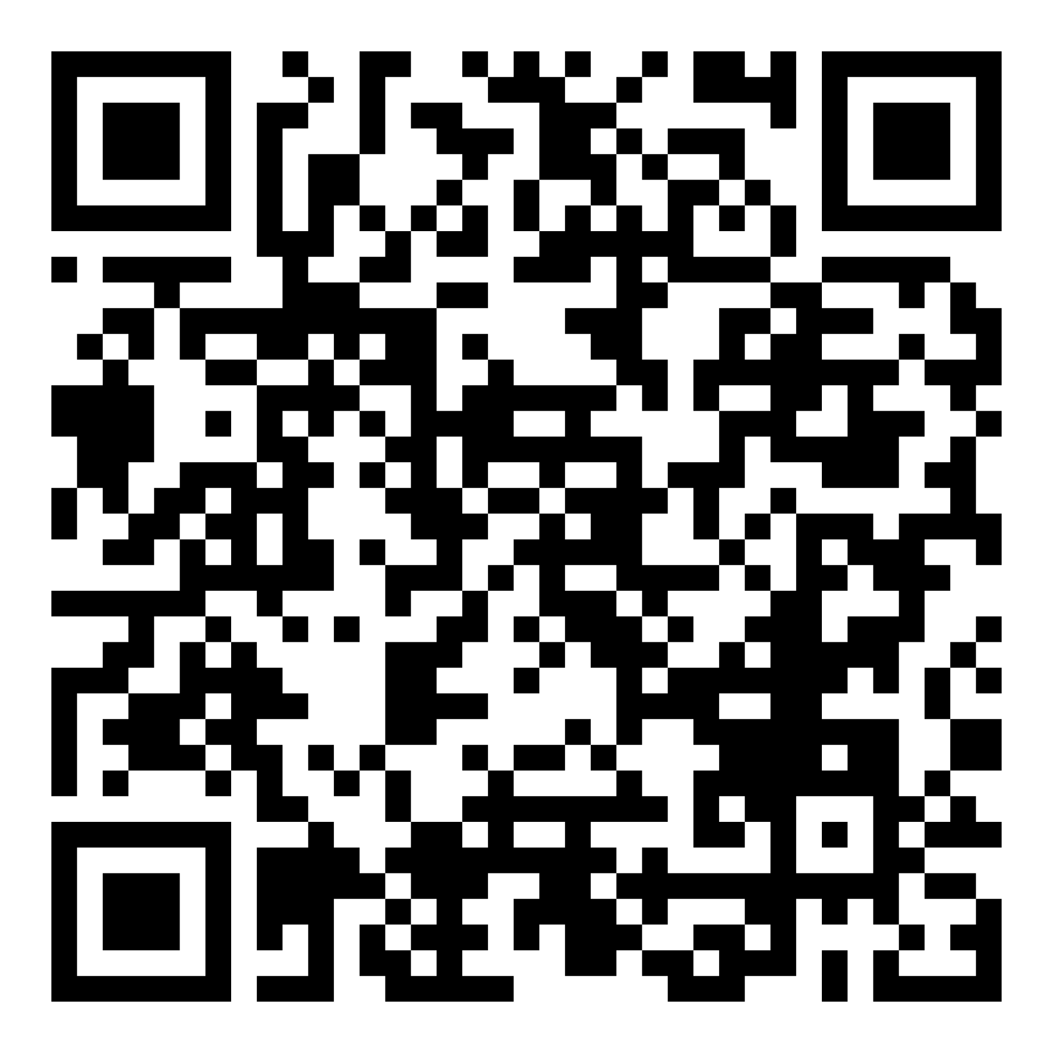
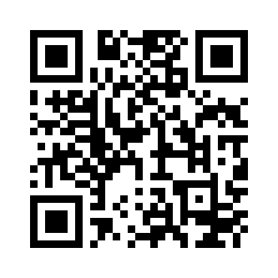
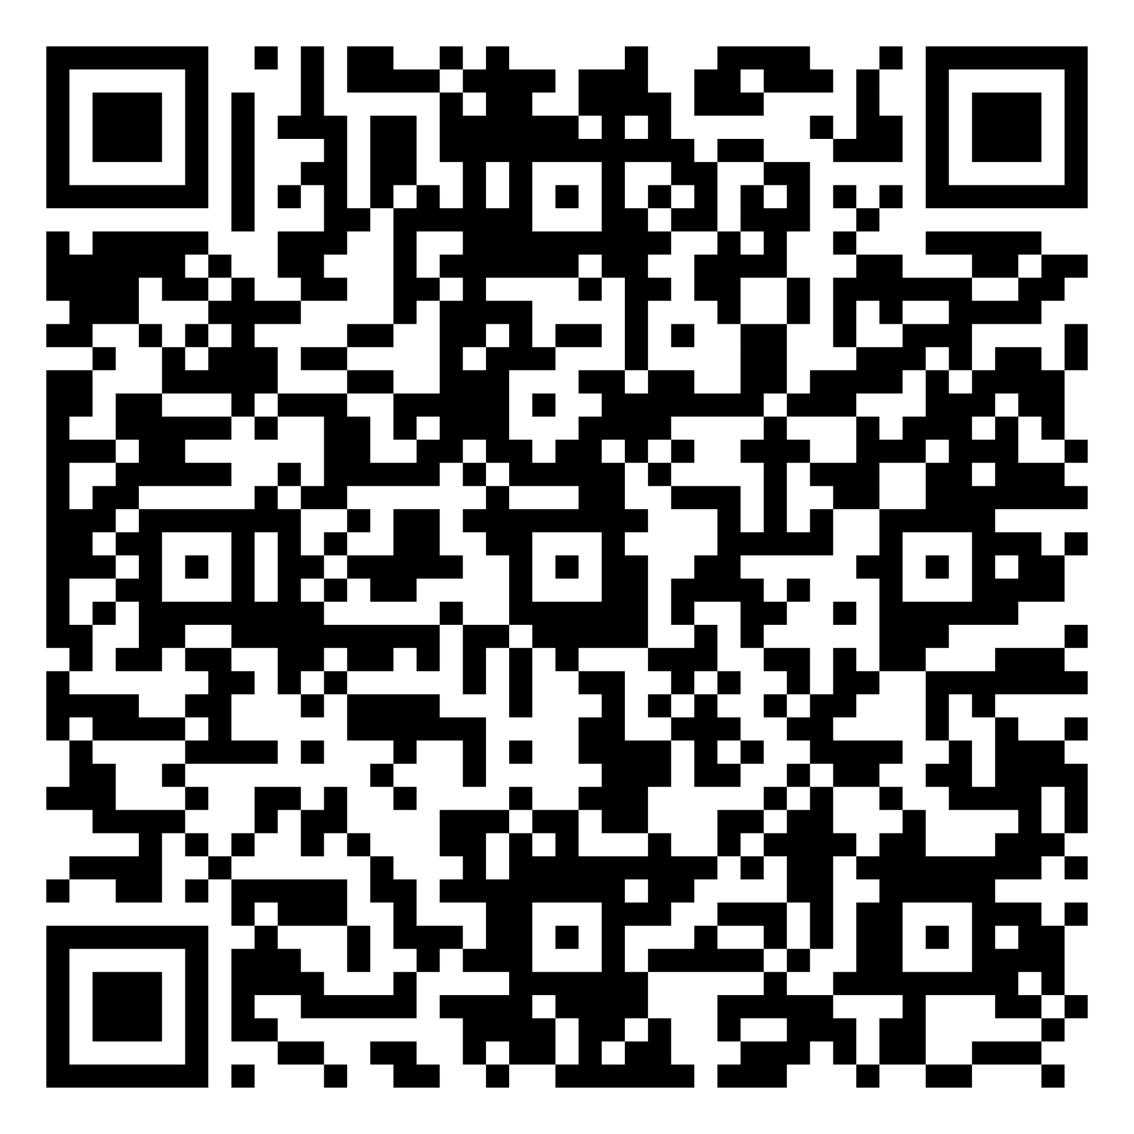
Help and support
Implementation plan - scan the QR code
Strategic Transition Planning Statement Guidance - scan the QR code
Strategic Transition Planning Statement online form - scan the QR code
Consultation response, equality impact assessment, Transition Plan - scan the QR code
16-19 Performance Measures Consultation - scan the QR code
Sign up to our mailing list: scan the QR code
Ofqual Qualification reform hub - scan the QR code

Slide 21
Questions

