Slide 1
T Levels results
Provider toolkit summer 2026

Slide 2





Celebrating T Level Results this August
The fifth cohort of T Level students will be receiving their results on 13th August. We would love you to get involved with marking this moment and celebrating the successes of T Level students.
Up to and on T Levels Results Day, the Department for Education will showcase students, providers and employers on our social media channels. Our Secretary of State, Ministers and Permanent Secretary will show their support for T Levels with social posts and interviews. We will also use our business and stakeholder networks to amplify and share T Level stories and messages.
How You Can Support
To support your activity during T Levels Results Day, we have created a range of content in this pack for you to use, including newsletter copy and draft social posts, so that you can adapt them and share on your channels.
    T Levels Results Day is a great opportunity to emphasise that T Levels are a high-quality qualification, and to help raise awareness of them in your area and across the country, driving registrations for September 2026 and beyond. There are a number of ways for you to participate, such as:
    sharing the experiences and successes of your T Level students across your social media channels
    hosting a T Level Results Day event
    showcasing your star T Level teachers or the T Level subjects you offer.
T Level providers across the country will be taking part through events, PR and social media, using the dedicated hashtags #TLevelResultsDay and #Results2026
If you have any questions about the following content or want to find out more about celebrating T Levels this summer, please contact: tlevel.delivery@education.gov.uk
LEGEND
Advice, hints & tips
Tools for you and colleagues
Ask for your participation

Slide 3
Contents
This document contains the following tools and content for you to use:
Products
Sample social media post copy
Examples of T Levels success stories
Request for your employer networks
Guide to creating video content
Sample newsletter content
Useful links

Slide 4
Products
Dedicated Hashtags
The hashtags for T Levels Results are #TLevelResultsDay and #Results2026. The Department for Education will be sharing a range of celebratory content on its channels using these hashtags - as will other providers and employers across the country. Please use one of these hashtags on all social media content you share to help drive interest in T Levels.
T Levels templates and designs
We have developed a collection of leaflets, posters and templates for promoting T Levels which you can adapt for T Levels Results Day. Please note that the photography that features in some of these templates must be swapped for your own or removed when using these resources.
Organising your own event
We would also encourage you to arrange your own T Level Results event – this could include a celebration or award ceremony for your T Level students, marking the moment they get their results.
If you have plans to hold your own event, do let us know by sharing images and updates from your event on social media using the hashtags #TLevelResultsDay #Results2026.

Slide 5
Sample social post copy
The following suggested social posts could be adapted and used on your social media channels. Mark this moment, celebrate your students receiving their results on T Levels Results Day (13th August), and continue to celebrate all T Levels students. Please use #TLevelResultsDay #Results2026 on all social media posts to help drive conversation around this topic.
Suggested social post copy | Suggested imagery
The next cohort of T Level students is set to get their results! It’s been a fantastic two years for them and we are so proud of their achievements. T Levels were designed by employers to meet industry needs and we’re excited to see what all of our students do next #TLevelResultsDay #Results2026 | Images of T Level students/ T Level classroom/facilities
Did you know every T Level includes an industry placement? This month, our [first/second/third/fourth/fifth] cohort of T Level students will get their results and are moving on to their next step including skilled work, further study and higher apprenticeships. Find out more about our T Levels courses visit [enter Provider URL] #TLevelResultsDay #Results2026 | Images of T Level students on their industry placement
T Level student [name] has just finished studying their T Level in [enter course] and is going on to [enter job, university or apprenticeship next step] We’re so proud of [name] and everything our T Level students have achieved. Find out more about our T Levels courses visit [enter Provider URL] #TLevelResultsDay #Results2026 | Images of T Level students and employer/in classroom
Congratulations to our T Level students getting their results today! Our students have had a fantastic two years and we’re incredibly proud of the progress they have made. If you’re interested in taking a course that blends classroom learning with an industry placement, find out more about T Levels here: visit [enter Provider URL] #TLevelResultsDay #Results2026 | Images of T Level classroom/facilities
Interested in following in the footsteps of our fantastic T Level students? From [insert course e.g. health] to [insert course e.g. education and early years] - we now have a wide range of brilliant T Levels available. To find out more visit [enter Provider URL] #TLevelResultsDay #Results2026 | Images of T Level students T Level classroom/facilities
Did you know that T Level industry placements offer students hands-on experience in their chosen field? Over a quarter of T Level students from the third cohort who progressed into work got jobs with their Industry Placement employer. #TLevelResultsDay #Results2026 | Images of T Level students and employer/in classroom
[Student name] started their T Level Foundation Year in [date]. Now they’ve just finished their T Level in [Subject] and are going to a [higher apprenticeship] at [Employer name]. . #TLevelResultsDay #Results2026 | Image of TLFY student and employer/in classroom

Slide 6
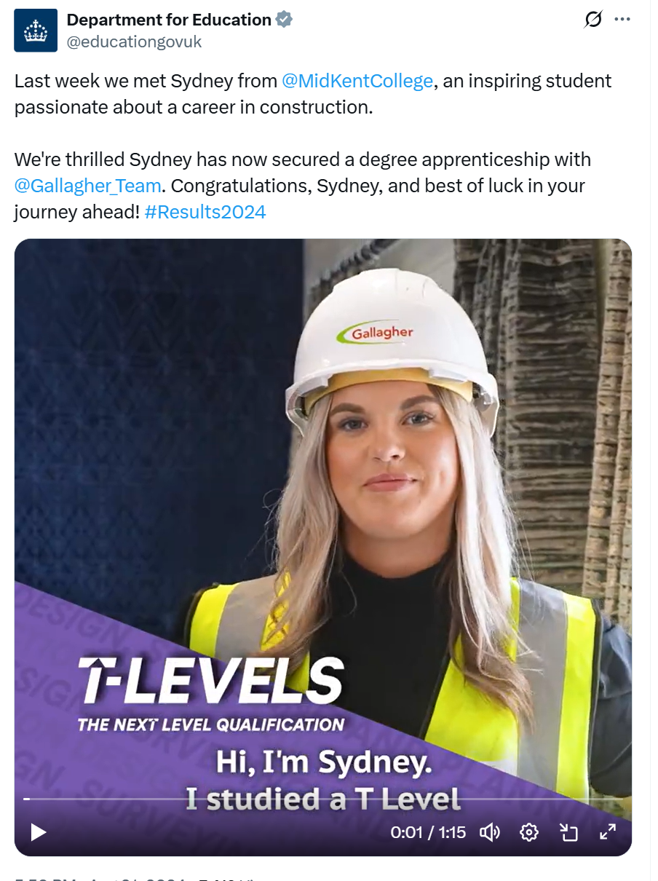
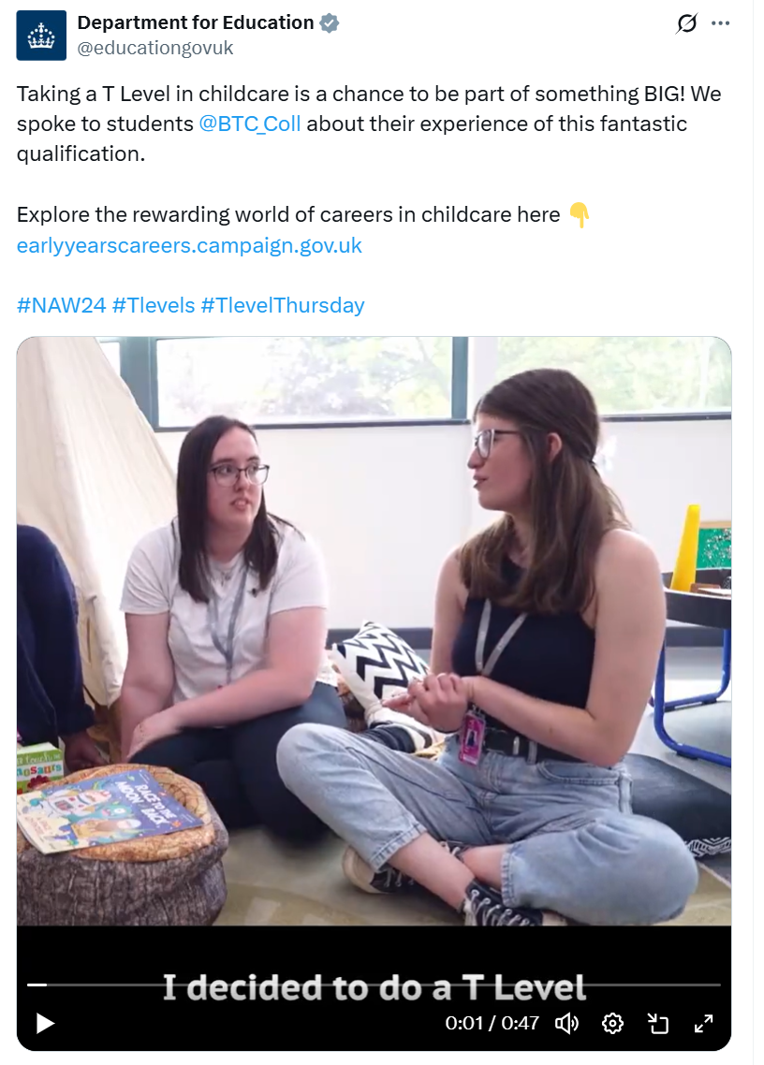
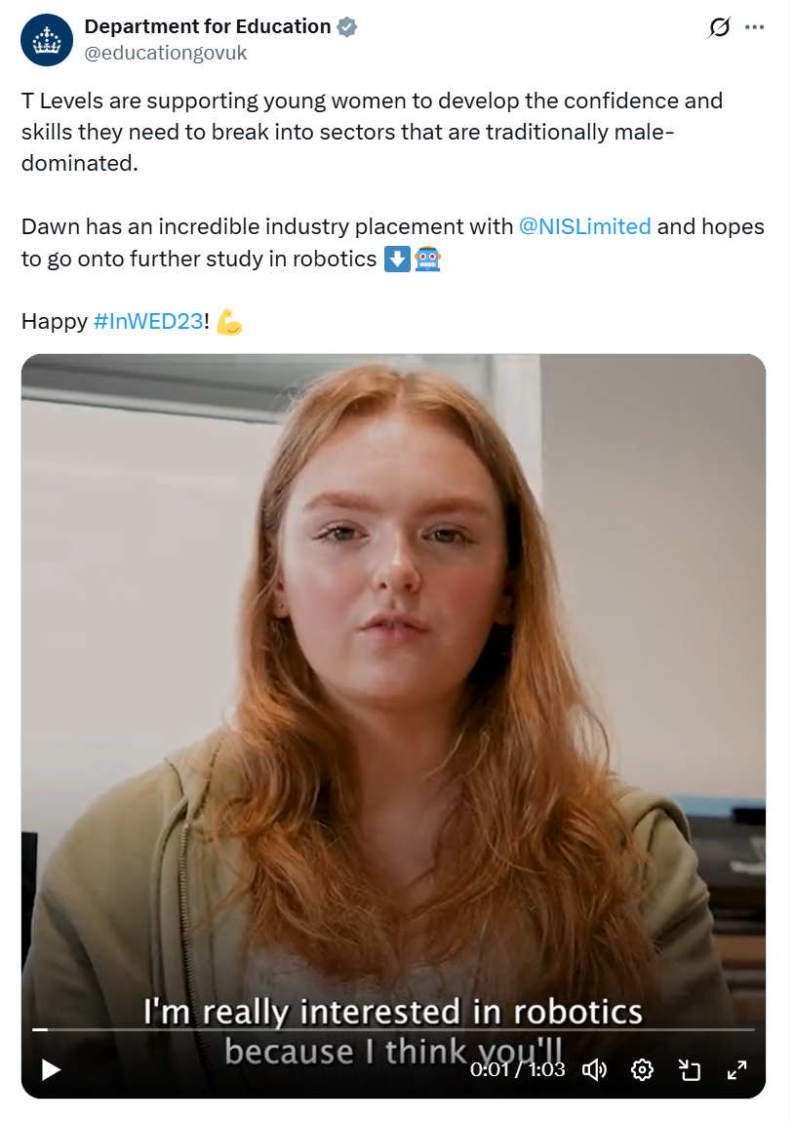
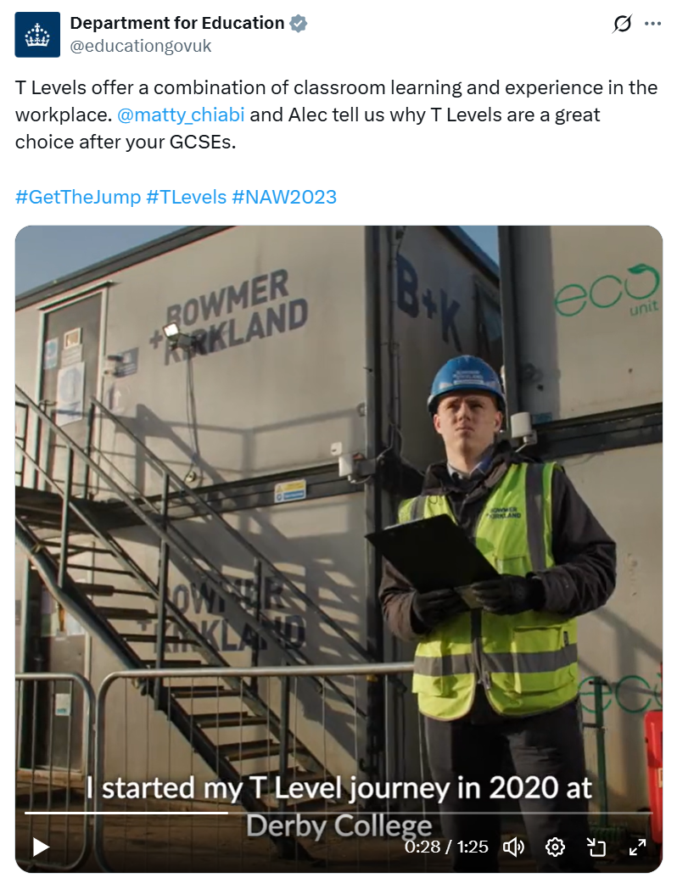
T levels success stories in social media - examples
https://t.co/UIV2iuzXv2" / X
https://t.co/BDcIF0k1Hw" / X
https://t.coHj4A2jE3s9" / Twitter
https://twitter.com/educationgovuk/status/1624064261558267904

Slide 7
Employer networks
Please encourage your employer networks to engage with results activity. See below information you can share with your employer networks to encourage them to engage with results activity online to help spread the word on the benefits of T Levels for local businesses.
Information to share:
We are supporting the Department for Education (DfE) to reach out to existing T Level employers through different channels to ask them to engage with online exam results activity. We are using the hashtag #TLevelResultsDay and #Results2026 on this year’s social media activity.
There are three asks of you:
1. Follow the dedicated @TLevels LinkedIn account and like and share exam results posts on 13th August and beyond
2. For members of the T Level Ambassador Network who have hosted T Level students on industry placement, share your successes in retaining T Level students in your business – in full time roles or on apprenticeships or Higher Technical Qualifications. Whether you work in the construction, digital or health sectors, remember to tag us and DfE in so we can easily find, like and share your posts
3. On T Level results day, spread the word on via your corporate social channels about the benefits that T Level students can bring to employers and how they can be part of your future workforce!
Find out more about the Employer Support Fund which can help with the costs of hosting a T Level student in your business.

Slide 8
Guide questions for video content
This is a great time to hear from your T Level students as they reflect on the last two years. We want to show that T Levels are an excellent choice for many young people and can lead to a happy, fulfilling future with good progression.
Overview
To showcase your own students by creating case studies, we’ve drafted a guide below to help you produce content yourself. If you create any content celebrating your T Levels students, then please do share it with DfE so we can consider it for use on our channels too. Please send content to TLevel.Delivery@education.gov.uk.
To keep the content as natural as possible, we would recommend your T Level students keep it personal – focusing on their own experiences. Questions to guide their talking points for the video include:
  Why did you choose to take a T Level instead of another option?
  For those students who came through T Level Foundation Year programme: How did your T Level Foundation Year Programme help prepare you for success on your T Level?
  ​What career guidance or advice did you receive to help you make your decision?
  What do your parents think about T Levels?
  What appealed to you about your specific course?
  What were the highlights of your course?
  Where did you do your industry placement?
  What’s next for you?
  What would you say to others considering a T Level? Would you recommend it?
  Where can people find out more? Search Skills for Life to find out more.
Note – you may also find these questions useful if you are producing written case studies that celebrate your T Levels students for your website and PR.
Considerations
You should ask your students participating in case studies if they are happy to sign a written consent form which should outline clearly how their data and content will be used.
You should not share any identifying personal data, such as full names. All data should be treated in line with your data protection guidelines.

Slide 9
Advice for filming
We recommend you film no more than 1-2 minutes of content to keep the video snappy and engaging. The tone should be relatively relaxed and informal, and you could try to film it in short bursts if easier if you are able to edit it together afterwards. We recommend the final video is around 30 – 60 seconds in length so it is shareable across social channels.
Top tips for filming (to share with students)
Wear something with plain colours, not grey or stripy
Have your phone at least 1.5m from your face
Landscape orientation is better than portrait
Stand just off-centre of frame, talking directly to camera
In the frame you should be waist up with a little bit of space above your head and any props in shot
Light source should be in front of you, not behind
Find a room with minimal background noise
Phone should be at eye level and not angled up or down
See if you can prop the phone somewhere rather than someone holding as the shaky image may not be consistent next to the other shots
    Call to action
To get the most out of the video content, make sure you include a clear call to action on an end slate and in any social posts you share about the video – i.e. Search Skills for Life to find out more about T Levels or For more information on T Levels and for advice on applying visit [enter Provider Name relevant URL].

Slide 10
Newsletter content template
The following suggested template copy is for you to adapt and use in your newsletter, blog or on your website so you can share the successes and progress of your first cohort of T Level students. Please share this via your channels during T Levels Results Day.
NEWSLETTER
Celebrating T Levels students this summer!
This summer marks the first/second/third/fourth/fifth cohort of T Level students finishing their courses and getting their results. We’re so proud to be marking this moment and celebrating the success of our students. We started offering T Levels in [X insert qualification names X] in 202X We have now expanded our T Level offer to include [insert additional courses available from September 2026 if applicable].
T Levels are two-year courses that a young person can take following GCSEs. They are broadly equivalent in size to 3 A levels and accrue UCAS points. T Levels were developed in collaboration with employers to ensure students will be equipped with the skills they need. They offer a mixture of classroom learning and ‘on the job’ experience with at least 45 days spent on an industry placement with an employer. With a T Level, students can progress straight on to skilled work, higher study or apprenticeships. We’ve seen some great outcomes for T Level students across England. Over a quarter of T Level students from the third cohort who progressed into employment got jobs with their T Level Industry Placement employer. And similar to previous years, 81% of T Level students who applied to Higher Education in the 2025 admissions cycle secured a place.
We’re really proud of our first/second/third/fourth/fifth cohort of T Level students. They are moving on to such a wide range of next steps, with some going straight into the workplace and others starting a higher-level apprenticeship or going to university [add examples where possible]. We’re looking forward to seeing how they succeed in the future.
Join us on social media as we celebrate our students this summer, we will be sharing content with the hashtag #Results2026 #TLevelsResultsDay
For more information on T Levels and for advice on applying visit [enter Provider Name relevant URL].

Slide 11
Useful links
Below are some links to content and resources that you may find useful when developing your own Results Day comms:
T Levels website
T Levels support for providers
Skills for Life
Resources for teachers and careers advisers
T Levels support for employers
Please also sign up for the TVQ newsletter to hear updates on T Levels and the post-16 reforms.
To register to become a T Level Ambassador, please sign up here.

Slide 12
Thank you

