Slide 1
What are AAQs and reformed Technical Qualifications?
ADD TEACHER NAME HERE

Slide 2
WHAT DOES AAQ stand for? WHAT IS A REFORMED TECHNICAL QUALIFICATION?

Slide 3
Learning outcomes:
By the end of this session, you should:
Be able to explain what an AAQ and Reformed Technical Qualification is
Explain what progression options you would have if you choose to study one of these qualifications

Slide 4
THINK ABOUT THESE QUESTIONS:
Who has a plan for when they leave school?
What are your options after leaving school?
Which options are you currently considering?
DISCUSS WITH THE PERSON SITTING NEXT TO YOU AND BE PREPARED TO FEED BACK

Slide 5
THE MAIN POST-16 options FROM September 2025
A levels or AS levels (Level 3 Qualification)
T Levels (Level 3 Qualification)
Apprenticeship (Level 2/3 Training)
Alternative Academic Qualifications * (Level 3 Qualification)
Reformed Technical Qualifications * (Level 2/3 Qualifications)
Applied General Qualifications (Level 2/3 Qualifications)
T Level Foundation year (Level 2 Study programme)
*NEW FOR 2025

Slide 6
Comparing POST-16 OPTIONS SEPTEMBER 2025
 | A levels Level 3 | T Levels Level 3 | Apprenticeship Level 2/3 | Alternative Academic Qualifications Level 3 | Reformed Technical Qualifications Level 2/ 3 | Applied General Qualifications Level 2/ 3 | T Level Foundation Year Level 2
Where would you study for these? | At a Post 16 college (FE or Sixth form) or school based sixth form provision. | At a Post 16 college (FE or Sixth form) or school based sixth form provision. | Work for an employer and part-time study. | At a Post 16 college (FE or Sixth form) or school based sixth form provision. | At a Post 16 college (FE or Sixth form) or school based sixth form provision. | At a Post 16 college (FE or Sixth form) or school based sixth form provision. | At a Post 16 college (FE or Sixth form) or school based sixth form provision.
Main focus | Academic study to support progression to higher education. | Employer-designed to prepare for skilled employment or further study. | Job-specific training in the workplace with part-time study. | Blend of academic and applied learning for HE entry. | Prepare for occupational roles | Applied learning for HE or work; often taken with A levels. | This level 2 programme provides a high-quality route onto T Levels for students who would benefit from additional study and preparation time.
Length of study | Usually 2 years full-time study. | 2 Years full-time study. | Usually 1-2 years. | Usually 2 years full-time study. | This depends on the qualification size and part-time/ full-time study. | Usually 1-2 years full-time study. | Usually 1 year of full-time study.
Study/ training focused | Classroom-based. | 80% classroom-based, some with workshops, labs and specialist settings, 20% industry placement. | Work-based, while studying for a qualification. | Classroom-based. | Classroom-based, some with workshops, labs and other specialist settings. | Classroom-based. | Classroom-based.
What could they lead to? | Progression to Higher Education (Undergraduate degree/ HTQ), employment or an apprenticeship. | Progression to skilled employment, higher education (Undergraduate degree/ HTQ), or a higher-level apprenticeship. | Progression to skilled employment, higher education (Undergraduate degree/ HTQ), or a higher-level apprenticeship | Progression to Higher Education (Undergraduate degree/ HTQ), employment or an apprenticeship. | Progression to skilled employment, higher education (Undergraduate degree/ HTQ), or a higher-level apprenticeship | Progression to employment, higher education (Undergraduate degree/ HTQ), or a higher-level apprenticeship | Progression to a T Level or other level 3 qualification or level 2 apprenticeship.

Slide 7
What are the new, reformed qualifications?
NEW QUALIFICATIONS
Approved for first teach 1 August 2025.
Level 3 only
Alternative Academic Qualifications (AAQs).
Level 3 and Level 2
Reformed Technical Qualifications- Technical Occupational Qualifications and Additional Specialist Qualifications.
Available in subjects aligned to Construction and the Built environment, Digital*, Education and early years, Engineering and manufacturing and Health and Science routes.
*only available at level 3

Slide 8
Alternative Academic Qualifications (AAQs)
What are they?
Level 3 qualifications
Designed to support entry to higher education
Blend academic and applied learning
Usually the same size as 1 A level or AS level but can be slightly larger.

Slide 9
REFORMED TECHNICAL QUALIFICATIONS
What are they?
Technical Occupational Entry Qualifications.
These qualifications focus on real-world skills that employers value because they are based on employer led occupational standards.
You will learn by doing, which is ideal if you prefer practical training over theoretical study.
They are based on occupational standards co-designed with employers.
At level 3, for 16–19-year-olds they will not cover content already included in T Levels
These can be any size.
Technical Occupational Additional Specialist Qualifications
These are specialist technical qualifications for post 16 learners and adults.
They will allow a student to develop
additional knowledge and competencies and specialise within a sector
They go further than an occupational standard to build on knowledge covered by a T Level or other occupational entry qualification.

Slide 10
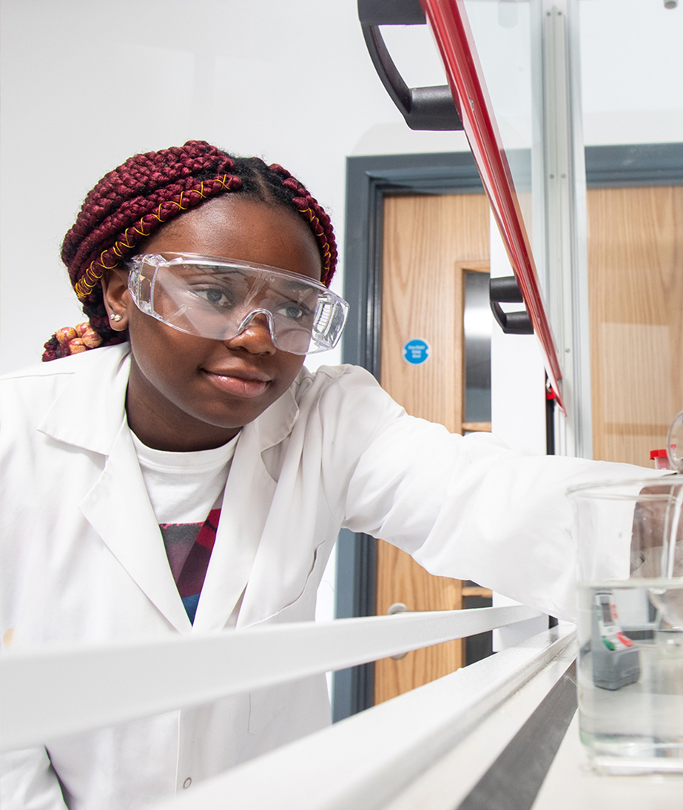
WHAT COULD MY STUDY PROGRAMME LOOK LIKE?
Chris (16 years old) wants to be a primary school teacher
Chris enrols on a level 3 study programme, which could include:
A levels e.g. English Language, Art and Design
Alternative Academic Qualification e.g. (AAQ) in Early Childhood Development
Chris enrols at university to continue studying towards becoming a teacher
Hayley (16 years old) wants to be a Pharmacy Technician
Hayley enrols on a study programme that could include
Level 3 Technical Occupational Entry in the Principles and Practice for Pharmacy Technicians (Diploma)
Alternative Academic Qualification (AAQ) in Human Biology (Extended Certificate)
Resit English GCSE
Hayley begins a job in her local pharmacy as a Pharmacy Technician

Slide 11
What questions do you have about these qualifications?
DISCUSS WITH THE PERSON SITTING NEXT TO YOU AND BE PREPARED TO FEED BACK
What do you want to know?
Do you think any of these qualifications would work for your next steps?

Slide 12
IN SUMMARY
 | Alternative Academic Qualifications Level 3 | Reformed Technical Qualifications Level 2/ 3
What is the purpose of these qualifications? | Designed to support entry to higher education and include elements of applied learning. | These qualifications focus on real-world skills that employers value because they are based on employer led occupational standards.
Where would you study for these? | At a Post 16 college (FE or Sixth form) or school based sixth form provision. | At a Post 16 college (FE or Sixth form) or school based sixth form provision.
Length of study | Usually 2 years full-time study. | This depends on the qualification size and part-time/ full-time study.
Study/ training focused | Classroom-based. | Classroom-based, some with workshops, labs and other specialist settings. May include a work placement
What could they lead to? | Progression to Higher Education (Undergraduate degree/ HTQ), employment or an apprenticeship. | Progression to skilled employment, further and higher education (Undergraduate degree/ HTQ), or a higher-level apprenticeship

Slide 13
LEARNING CHECK
What makes these qualifications different to other pathways?
You should now be able to:
explain what these new qualifications are
explain what you could progress on to from one of these qualifications.

Slide 14
Next steps
If you are interested in one of these qualifications or in any of the other routes that we have talked about today:
Follow the links in this presentation to find out more. | Visit our webpages to find out more about the options. | Arrange to see a careers adviser to talk through your options and find out more about how to apply. | Talk about your choice with your parents and your teachers. | If possible reach out to the education or training provider and ask what they are looking for before you apply.

Slide 15
Do ONE THING!
Make a note of one thing that you will do after this session to help you take your next steps.

