Slide 1
INTRODUCTION CONSTRUCTION
SUPPORTING NOTES - DELETE BEFORE PRESENTING
This is an outline slide deck to introduce the Construction T Level Route to Employers
Key T Level messages have been included throughout however; each slide is editable to customise it to your specific T Level offer.
Branding has been kept to a minimum to allow you to apply your own logo’s, imagery and style, however, where possible please align this to the T Level Branding Guidance
<xxx> is used to indicate where an insertion of specific detail is required by you. Please overtype this and remove the highlighting.
There may be further guidance and / or speaker notes within the notes section of each slide.
Notes:
SPEAKER NOTES:
Welcome audience and carry out any required introductions.

Slide 2
SESSION AIMS
Introduce you to the Construction T Levels including occupational specialisms and industry placements
Answer your initial questions
Gauge your interest in offering a <school/college> student an industry placement
Notes:
SPEAKER NOTES:
This session is aimed to give you an overview of the Construction T Level, the occupational specialisms and the industry placements
I will provide you with an overview of the programme, tell you a little about our students and why you might be interested in hosting a student in your workplace. We will explore the types and projects and tasks a student would typically be involved in whilst on their industry placement, describe how our placement model works and answer any questions.
Finally, I am keen to understand if you remain interested and if you would like to progress this further.

Slide 3
construction
The Construction skills area has 3 T Levels for students:
Building Services Engineering for Construction
Design, Surveying and Planning for Construction
Onsite Construction
Each is a 2-year course that equips students with practical and technical skills they need for employment in the industry
Notes:
NOTES:
You may need to edit this slide to reflect the T Levels that your organisation offers, if you choose to do this you may also want to edit the whole slide pack to be relevant to just one.
There may however be some value in sharing the wider offer with employers as you may gain some useful intelligence and understanding on which T Levels employers would be most interested in, which could support future curriculum planning.

Slide 4
Building Services Engineering for Construction T Level
Students at <school/college> will study one of the following occupational specialisms:
Electrical and electronic equipment engineering
Electrotechnical engineering
Gas engineering
Protection systems engineering
Plumbing and heating engineering
Heating engineering and ventilation
Refrigeration engineering and air conditioning engineering
Students will develop a deep understanding of industry issues including:
health and safety
making accurate, appropriate measurements
construction methods
building regulations and standards
how the Internet of Things (IoT) impacts construction
digital engineering techniques
construction design principles and processes
sustainability and the environmental impact of construction
Notes:
NOTES:
You may need to edit this slide to reflect the occupational specialisms that your organisation offers. Whilst you could remove those you don’t there could be some value in understanding which employers would be most interested in to support your future curriculum planning.
SPEAKER NOTES:
Provide a high-level overview of the Building Services Engineering for Construction T Level.

Slide 5
THE COURSE – BUILDING SERVICES ENGINEERING FOR CONSTRUCTION
80%
Up to 1400 hours
TECHNICAL QUALIFICATION
BUILDING SERVICES ENGINEERING FOR CONSTRUCTION
Core
English and maths
Occupational specialisms
Electrical and electronic equipment engineering
Electrotechnical engineering
Gas engineering
Protection systems engineering
Plumbing and heating engineering
Heating engineering and ventilation
Refrigeration engineering and air conditioning engineering*
Other requirements:
CSCS Industry Placement Card
*F Gas Category 1 Certificate
2 years
20%
At least
315 hours
350 hours average
Technical skills and knowledge
Practical skills for employment
Meaningful contribution in the workplace
INDUSTRY PLACEMENT
Notes:
NOTES:
Choice to edit occupational specialisms, in line with your offer
SPEAKERS NOTES:
What makes up Building Services Engineering for Construction T Level
Core
Students learn knowledge, concepts, and principles about the route
The Core will be assessed through an exam and a project
Occupational specialism
Students choose a specialism
They will learn and be assessed on the knowledge and skills needed to do a specific job
This will be assessed through assignments and tasks, which might be part of the industry placement
Industry placement
This is time spent with an employer like you, making a meaningful contribution to your organisation
Students may spend up to one third of their total placement hours in an approved skills hub (such as the CITB’s) or employer training centre.
Other requirements
The employer panels who designed the T Level included specific requirements and accreditations that students will need in the workplace, again getting them ready for work. These could include additional training, certifications or memberships

Slide 6
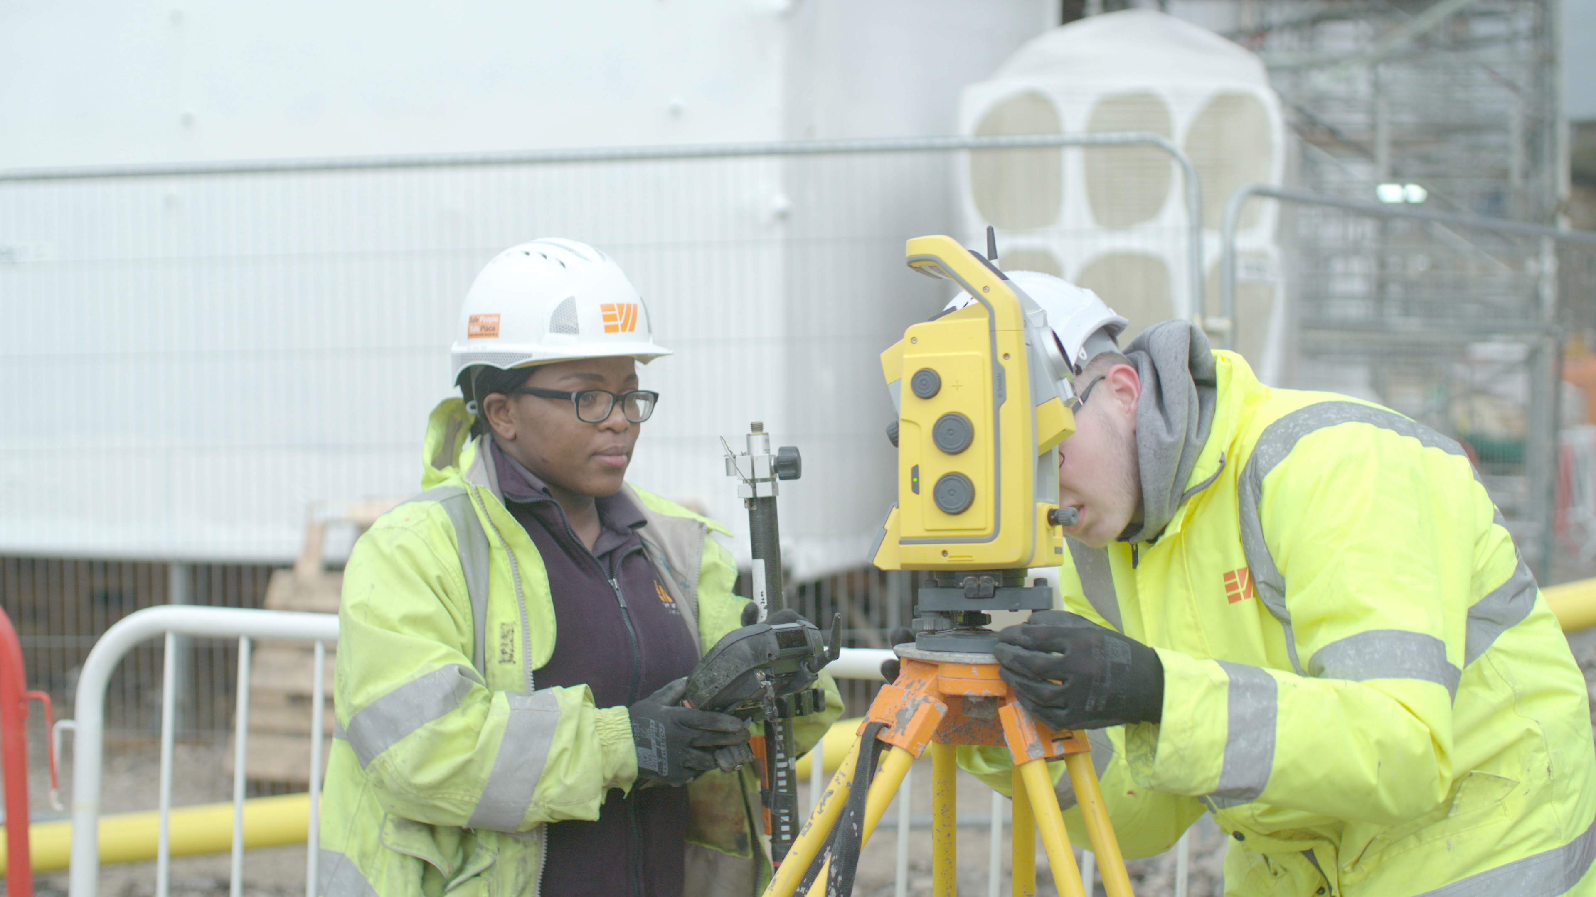
DESIGN SURVEYING AND PLANNING FOR CONSTRUCTION t LEVEL
Students at <school/college> will study one of the following occupational specialisms:
Surveying and design for construction and the built environment
Civil engineering
Building services design
Hazardous materials analysis and surveying
Students will develop a deep understanding of industry issues including:
health and safety
making accurate, appropriate measurements
construction methods
building regulations and standards
how the Internet of Things (IoT) impacts construction
digital engineering techniques
construction design principles and processes
sustainability and the environmental impact of construction
Notes:
NOTES:
You may need to edit this slide to reflect the occupational specialisms that your organisation offers. Whilst you could remove those you don’t there could be some value in understanding which employers would be most interested in to support your future curriculum planning.
SPEAKER NOTES:
Provide a high-level overview of the Design Surveying & Planning for Construction T Level.
Design Surveying & Planning for Construction T Level is a highly practical course that provides students with practical knowledge and skills required for employment in the construction industry.

Slide 7
THE COURSE – DESIGN SURVEYING AND PLANNING FOR CONSTRUCTION
80%
Up to 1400 hours
TECHNICAL QUALIFICATION
DESIGN SURVEYING AND PLANNING FOR CONSTRUCTION
Core
English and maths
Occupational specialisms
surveying and design for construction and the built environment
civil engineering
building services design
hazardous materials analysis and surveying
Other requirements:
CSCS Industry Placement Card
2 years
20%
At least
315 hours
350 hours average
Technical skills and knowledge
Practical skills for employment
Meaningful contribution in the workplace
INDUSTRY PLACEMENT
Notes:
NOTES:
Choice to edit occupational specialisms, in line with your offer
SPEAKERS NOTES:
What makes up Design Surveying & Planning for Construction T Level
Core
Students learn knowledge, concepts, and principles about the route
The Core will be assessed through an exam and a project
Occupational specialism
Students choose a specialism
They will learn and be assessed on the knowledge and skills needed to do a specific job
This will be assessed through assignments and tasks, which might be part of the industry placement
Industry placement
This is time spent with an employer like you, making a meaningful contribution to your organisation
Students may spend up to one third of their total placement hours in an approved skills hub (such as the CITB’s) or employer training centre.
Other requirements
The employer panels who designed the T Level included specific requirements and accreditations that students will need in the workplace, again getting them ready for work. These could include additional training, certifications or memberships

Slide 8
ONSITE CONSTRUCTION T LEVEL
Students will develop a deep understanding of industry issues including:
health and safety
making accurate, appropriate measurements
construction methods
building regulations and standards
how the Internet of Things (IoT) impacts construction
digital engineering techniques
construction design principles and processes
sustainability and the environmental impact of construction
Students at <school/college> will study one of the following occupational specialisms:
Bricklaying
Carpentry and joinery
Plastering
Painting and decorating
Notes:
NOTES:
You may need to edit this slide to reflect the occupational specialisms that your organisation offers. Whilst you could remove those you don’t there could be some value in understanding which employers would be most interested in to support your future curriculum planning.
SPEAKER NOTES:
Provide a high-level overview of the Onsite Construction T Level.
Onsite Construction T Level is a highly immersive course that provides students with practical knowledge and skills required for employment in the craft and design industry.

Slide 9
THE COURSE – ONSITE CONSTRUCTION
80%
Up to 1400 hours
TECHNICAL QUALIFICATION
ONSITE CONSTRUCTION
Core
English and maths
Occupational specialisms
Bricklaying
Carpentry and joinery
Plastering
Painting and decorating
Other requirements:
CSCS Industry Placement Card
2 years
20%
At least
315 hours
350 hours average
Technical skills and knowledge
Practical skills for employment
Meaningful contribution in the workplace
INDUSTRY PLACEMENT
Notes:
NOTES:
Choice to edit occupational specialisms, in line with your offer
SPEAKERS NOTES:
What makes up Onsite Construction T Level
Core
Students learn knowledge, concepts, and principles about the route
The Core will be assessed through an exam and a project
Occupational specialism
Students choose a specialism
They will learn and be assessed on the knowledge and skills needed to do a specific job
This will be assessed through assignments and tasks, which might be part of the industry placement
Industry placement
This is time spent with an employer like you, making a meaningful contribution to your organisation
Students may spend up to one third of their total placement hours in an approved skills hub (such as the CITB’s) or employer training centre.
Other requirements
The employer panels who designed the T Level included specific requirements and accreditations that students will need in the workplace, again getting them ready for work. These could include additional training, certifications or memberships

Slide 10
Skills and Experience
of OUR T Level Students
Students will have a broad understanding of scientific methodology and the science sector
Students will be trained in experimental equipment and techniques and skills required for their industry placement
Students will have developed teamwork, communication, health and safety and customer service skills
But it might be their first time in a workplace
They will need mentoring and supporting
Notes:
NOTES:
Use this slide to demonstrate to employers what value your students will bring, if you have some real examples or profiles of your students you could add this here.

Slide 11
Benefits of Hosting T Level Industry Placement StudentS
Fresh perspectives and innovative ideas from the next generation
Fill skills gaps now and identify potential employees for the future
Build a more diverse workforce
Contribute to a skilled future workforce in your industry
Develop your staff with supervision and mentoring experience
Enhance your profile and reputation as an employer
Contribute to social mobility
Notes:
NOTES:
If you have feedback from your employers about benefits they have found in hosting your students, add this into the slide here
SPEAKERS NOTES:
Here's what other employers say about hosting industry placements…

Slide 12
EXAMPLE Industry Placement PROJECTS AND TASKS
Interpret plumbing system information from specifications and technical manuals
Update online customer maintenance documents and records
Calculate resource and component requirements for maintenance assignments
Conduct research into potential civil engineering solutions
Notes:
NOTES:
This slide provides examples for both T Levels – if you only offer one or are pitching about only one please edit the examples.
SPEAKERS NOTES:
Industry placements provide students with the opportunity to work on a variety of projects that can directly contribute to business operations.
Construction T-Level student can undertake a variety of tasks during their industry placement.
Explore some of the bullets
You could also ask the employer about the typical work they undertake and establish if this in in line with the T Level.

Slide 13
THE placement MODEL
<Describe your delivery model - Typical delivery models include block, day-release, and staggered placements>
<When in the year are you looking for the IP to begin?>
<If you can be flexible make sure this is clear>
Notes:
SPEAKERS NOTES:
Industry placements can be delivered in a number of ways, depending on the needs of the employer and the student.
There are several delivery models that can be used, including block placements, day-release placements, and staggered placements.
Block placements involve the student working full-time for an extended period of time, usually 6-8 weeks, while day-release placements involve the student attending work one or two days per week over a longer period of time.
Staggered placements involve the student working part-time over a longer period of time.
Placements can also be project-based, with a specific focus on a particular project or task. Employers should work with the school or college to determine the most appropriate delivery model for their needs and the needs of the student.
Ask the employer if they, even at this early stage would have any preferences / would your model work for them? (BE CAREFUL NOT TO MAKE THIS A BARRIER – THEIR RESPONSE MAY MEAN FURTHER DISCUSSION ABOUT FLEXIBILITIES OF YOUR DELIVERY MODEL IS NECESSARY.)

Slide 14
Employer Commitments to Industry Placement Students
Provide a meaningful work experience, tasks and responsibilities related to the T Level course
Provide on-the-job training and support during the placement
Treat the student fairly and with respect,
Make sure the student is always safe
Provide regular feedback and opportunities to review progress
Help the student develop employability skills and prepare for their future career
Adhere to relevant laws and regulations, including health and safety, data protection, and equality and diversity
Notes:
SPEAKER NOTES:
Employers who offer industry placements make a commitment to provide valuable training and work experience to T-Level students.
Employers are responsible for ensuring that the student is treated fairly and respectfully and is provided with meaningful tasks and responsibilities.
Employers will also need to provide regular feedback and support, and help the student develop employability skills. It is important to adhere to relevant laws and regulations, including health and safety, data protection, and equality and diversity.
By offering an industry placement, employers can help develop the next generation of skilled workers and benefit from fresh perspectives and new talent in their organisation.
You may also wish to explain there are no requirements for payment, offer of a job longer-term etc.

Slide 15
Support During Industry Placements
We will
Provide you with a single point of contact
Work with you to design industry placement(s) that meet you and your students’ needs
Train students to help prepare for the placement and develop the skills and understand their responsibilities
Support students throughout, providing regular check-ins and feedback on their progress
Work with both you and the student to quickly resolve any issues during the placement
Notes:
NOTES:
During an industry placement, it is important that both employer and student are supported to ensure a successful outcome. In this slide, discuss how you will support both parties during the placement. You may wish to edit this slide with your specific approach however, this sets out the minimum expectations.

Slide 16
Progression for T Level Students
Students can progress
directly into skilled employment
to higher level apprenticeships or technical training
to university-level education in a related field
Career options are vast
Depending on the occupational specialism, these could include careers as a :
electric installation and maintenance
plumbing or heating
surveying and design
civil engineering
building services design
bricklaying
carpentry and joinery
plastering, painting and decorating
hazardous materials surveying
Notes:
NOTES:
If you offer a progression route such as an apprenticeship, make sure to make this part of the information – you want to demonstrate you can develop their workforce pipeline with T Levels and your wider skills offer.
Examples provided cover both T Levels, you may wish to edit to be relevant to just one T Level if you don’t offer both or if this is a targeted pitch at a particular employer.
SPEAKER NOTES:
This slide outlines the various progression routes available to Construction T Level students. Students can pursue higher education in a related field or enter the workforce directly. Various career options are available, including tradespeople, maintenance and building design. With experience, students can progress to roles such as site managers, surveyors and engineers.

Slide 17
COMMON QUESTIONS
WON’T IT TAKE TOO MUCH TIME?
It should be quite a quick process to design a placement and it will get quicker once you’ve had your first placement
The short- and long-term benefits will make it worth the time investment
WHO’S GOING TO LOOK AFTER THEM?
A supervisor and a mentor (could be the same person)
A great opportunity for staff to develop mentoring skills
WILL STUDENTS BE HIGH-CALIBRE?
T Levels are demanding courses
We will work with you to understand your needs and find students that fit well with you
You can also be involved in recruiting students
HOW CAN WE MAKE SURE STUDENTS ARE SAFE?
For some occupational specialisms in construction, it may be a requirement for industry placement students to have a CSCS trainee card
Notes:
SPEAKERS NOTES:
Open the discussion up for any questions…

Slide 18
READY FOR THE NEXT LEVEL?
If you’re interested in offering an industry placement :
Arrange to speak with one of our team who will explore the opportunity with you in more detail
Attend a briefing / forum <insert date/time>
Notes:
NOTES: Edit this slide as appropriate. This is the call for action for the employer this will depend on whether you are presenting this to a group of employers, or an individual employer.
SPEAKER NOTES:
<To be inserted by presenter>

Slide 19
WANT FURTHER SUPPORT WITH
Understanding and deciding whether to offer industry placements
Planning industry placements
Delivering industry placements
GO TO: employers.tlevels.gov.uk
Tools, guides, templates
Events
Advice
Hear from another employer
Notes:
NOTES:
If you have relevant case studies – provide links etc

Slide 20
Thank you for your time.
<INSERT CONTACT DETAILS (Phone, Email, Website, LinkedIn)>
More information and support can be accessed on gov.uk
Notes:
NOTES: Make sure the contact details you provide (phone and email) are manned and will be responded to in a timely way.
SPEAKER NOTES:
Thank audience for their time and ensure there is a clear route for further engagement.

